Slide 1
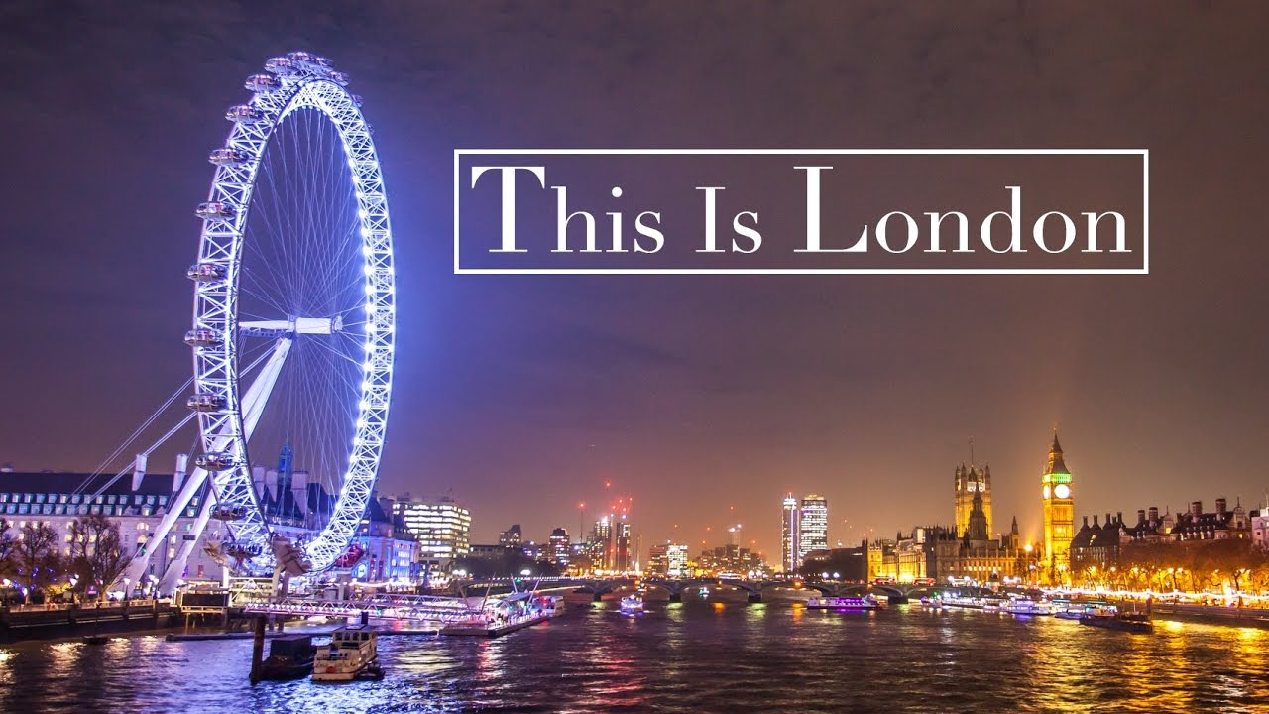

Slide 2
Go sightseeing |ˈsaɪtsiːɪŋ| - eiti įžymybių apžiūrėti,
осматривать достопримечательности
Wheel |wiːl|- ratas , колесо
Near here - netoli nuo čia, недалеко отсюда
Over |ˈəʊvə|- virš, над

Slide 3
Complete the sentences. Write the missing words: places, castle, Houses of Parlament, bell, toy shop, wheel, monument, Buckingham palace, bridges, department store
1) Harrods is a big ……
2) Hamleys is a ….
3) The Quinn lives in …
4)Nelson’s column is a famous ….
5) London eye is big….
6) Big Ben is the name of the ….. inside the tower.
7) The Prime minister and the government work in the ……..
8) There are a lot of …….. over the River Thames.
9) You can see interesting………. from a boat.
10) The Tower of London is a ….

