Slide 2
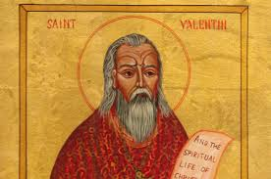
St.Valentine lives in the third century in Rome when Claudius II is the ruler of the country.
Century |ˈsentʃʊrɪ| - amžius, столетие, век
Ruler |ˈruːlə|–valdovas, правитель
Country |ˈkʌntrɪ| šalis,страна

Slide 3
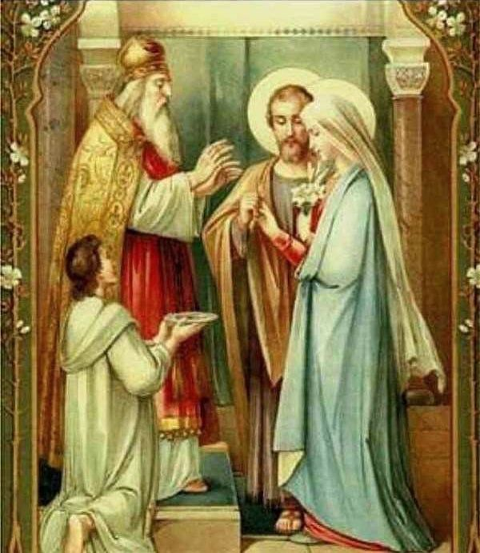
Many of the Romans are Christians - and one of them is Valentine.
St. Valentine is a priest . He marries some of his soldiers. But it is against the law.
Christians |ˈkrɪstʃənz|–krikščionys, христиане
Priest |priːst|kunigas, священник
Marry |ˈmærɪ| женить; выдавать замуж
Soldier |ˈsəʊldʒə| karys, солдат
Against |əˈɡenst| prieš, против
Law – закон

Slide 4
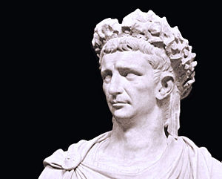
Claudius II does not like Christians. He loves having lots of soldiers to fight in his wars.
Fight |faɪt| kovoti, сражаться
War |wɔː| karas война

Slide 5
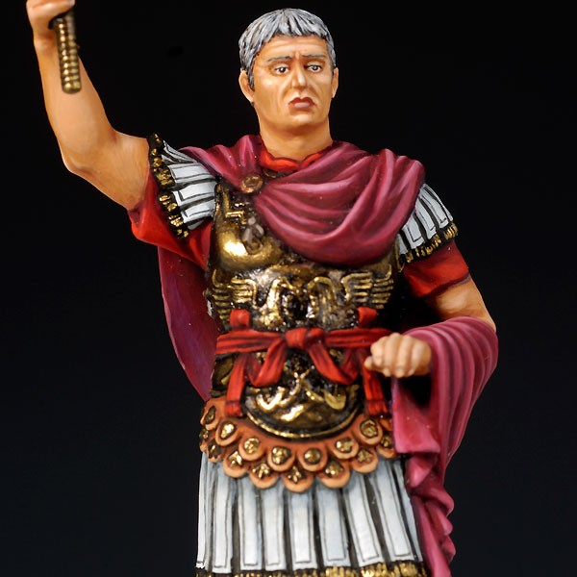
He makes a law that people can’t get married. Claudius II thinks that if young boys get married and have families they will not want to fight in his wars.
Get married - susituokti, вступать в брак

Slide 6
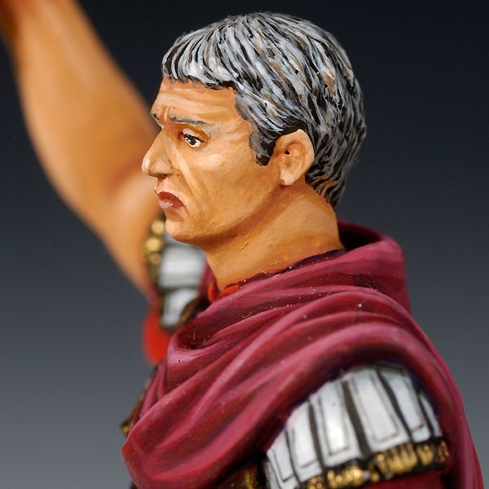
Claudius orderes to throw St. Valentine in prison. The emperor wants St. Valentine to pray to the gods of Rome.
Order |ˈɔːdə| įsakyti,приказывать
Throw|θrəʊ|mesti, бросать
Prison |ˈprɪz(ə)n| kalėjimas, тюрьма
Pray |preɪ| melstis, молиться
Gods |ɡɒdz| dievai, боги

Slide 7
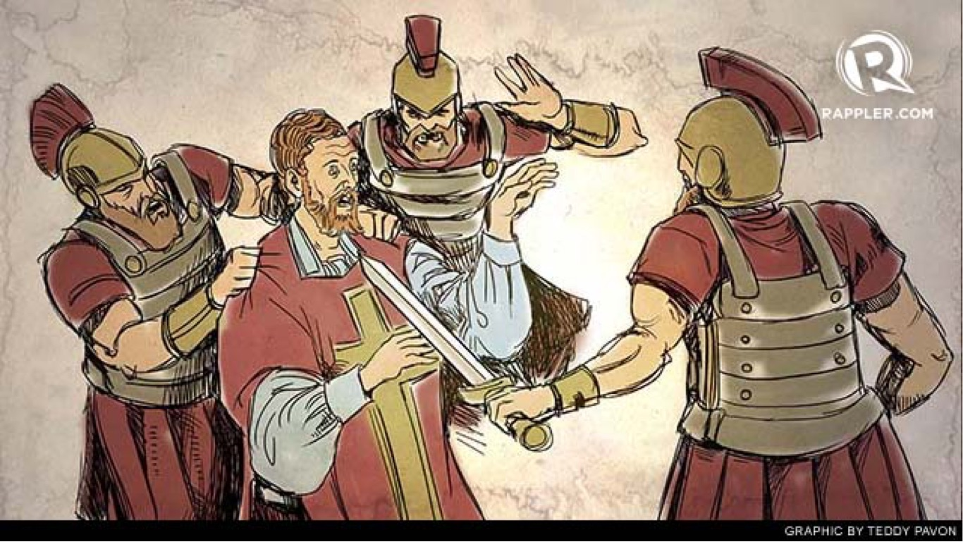
When he refuses, the emperor sentences the priest to death. Refuse |ˈrefjuːs| atsisakyti, отказаться sentence |ˈsent(ə)ns| pasmerkti , приговаривать, осуждать death |deθ| mirtis, смерть

Slide 8
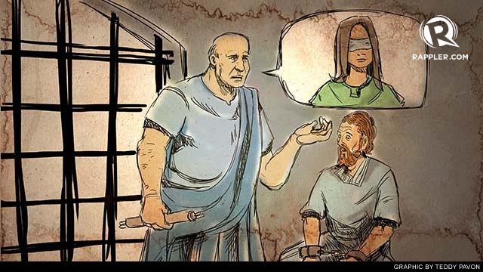
When Valentine is in prison, the jailer’s daughter brings him his food. She is blind. They spend long hours talking to each other, and fall in love.
jailer |ˈdʒeɪlə|kalėjimo sargas,тюремный смотритель
blind |blaɪnd|aklas, слепой

Slide 9
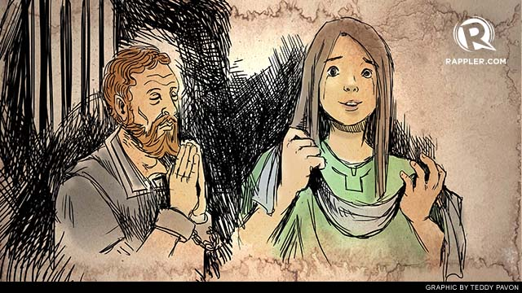
One day, Valentine touches the girl’s closed eyes. When she openes them again, she can see. It is a miracle.
touch|tʌtʃ|paliesti, прикасаться,
miracle |ˈmɪrək(ə)l| stebuklas, чудо

Slide 10
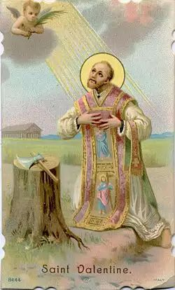
Valentine is killed on the 14 of February. On his last night, he writes his final letter to the girl. He signes his love letter, “From your Valentine”.
Sign |saɪn| pasirašyti, подписывать

Slide 11
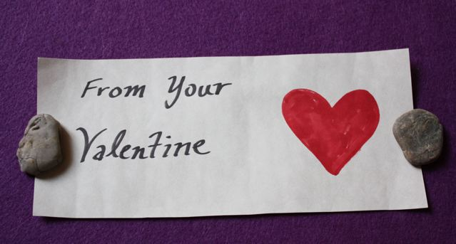
This happens in the year 270, and ever since, lovers have sent each other messages on February the 14th with the same words : “From your Valentine”.

Slide 12
Fill in the gaps with the missing words: marries, touches, prison, blind, brings, get married, signes, miracle, priest,century
St.Valentine lives in the third…………. in Rome.
He is a……. .
St.Valentine …………. some of his soldiers.
Claudius II makes a law that people can’t……………. .
Claudius orderes to throw St. Valentine in…………..
The jailer’s daughter ……….him his food.
She is………...
One day, Valentine …………..the girl’s closed eyes.
She can see. It is a…………..
St.Valentine writes his last letter and …….. it “From your Valentine”.

