Slide 1
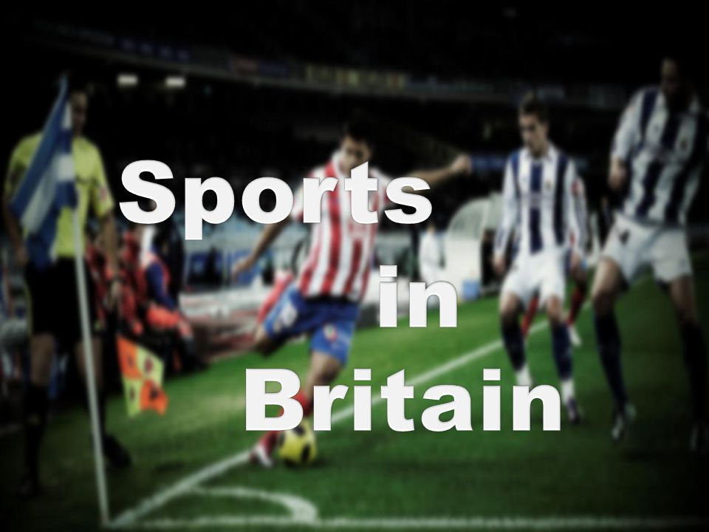

Slide 2
Venue |ˈvenjuː|vieta, место сбора
Tournament |ˈtʊənəm(ə)nt| turnyras, турнир
Headquarters | hedˈkwɔːtəz| štabas, штаб
Belong |bɪˈlɒŋ| priklausyti, принадлежать
Variety of |vəˈraɪətɪ| įvairovė, разнообразие
Trail |treɪl| takas, тропа
Facility |fəˈsɪlɪtɪ| įranga, priemonė, оборудование
Keep fit|kiːp| palaikyti formą быть в форме
Enjoy |ɪnˈdʒɔɪ|mėgautis, получать удовольствие
Competition |kɒmpɪˈtɪʃ(ə)n| varžybos, соревнование, Hurdle |ˈhɜːd(ə)l| nugalėti , преодолевать препятствия

Slide 3
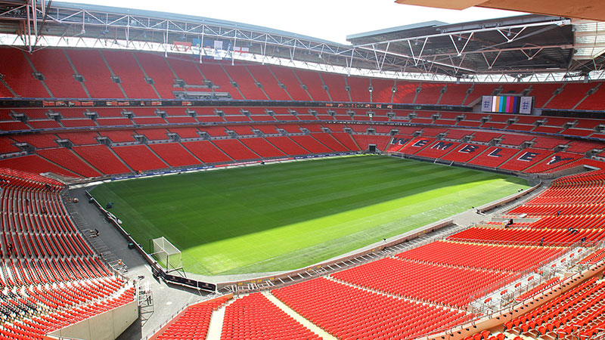
Wembley is one of the most famous stadiums in the world.

Slide 4
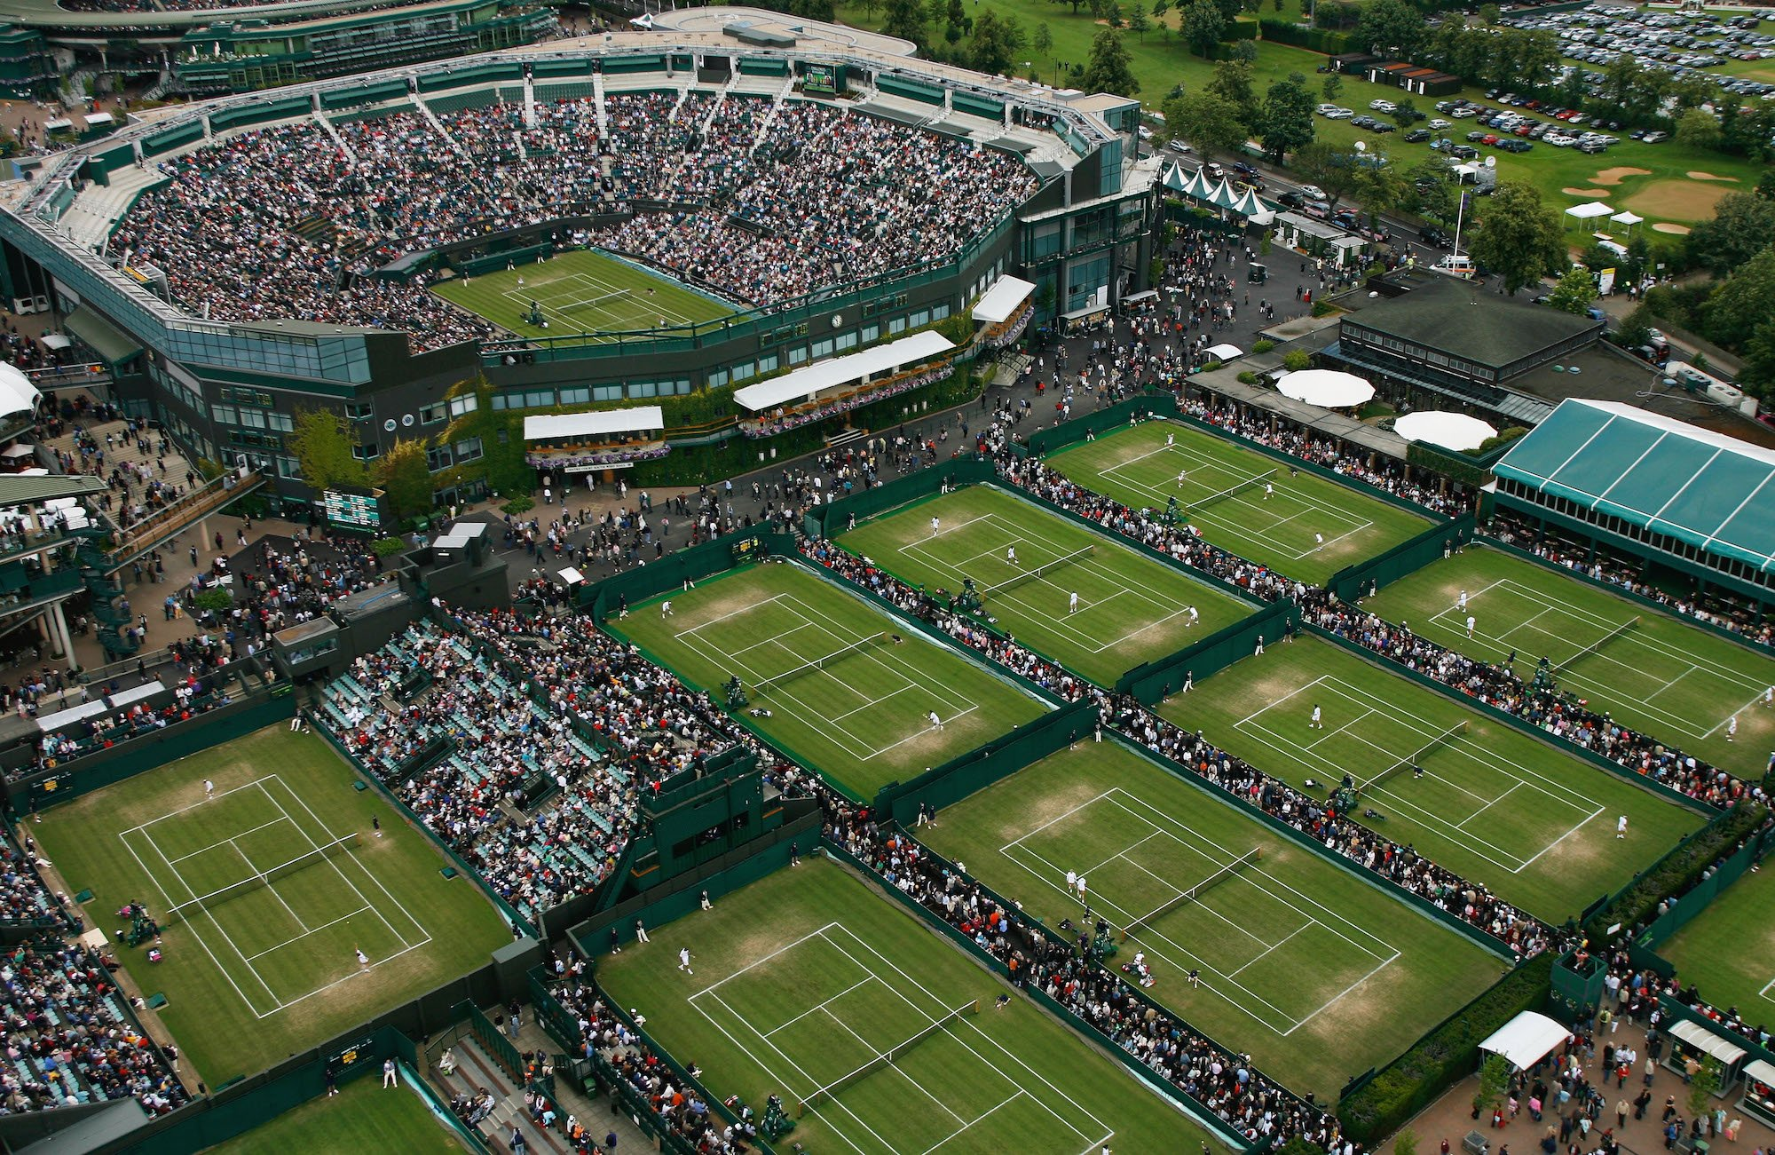
Wimbledon is the oldest tennis tournament in the world and the most famous one.

Slide 5
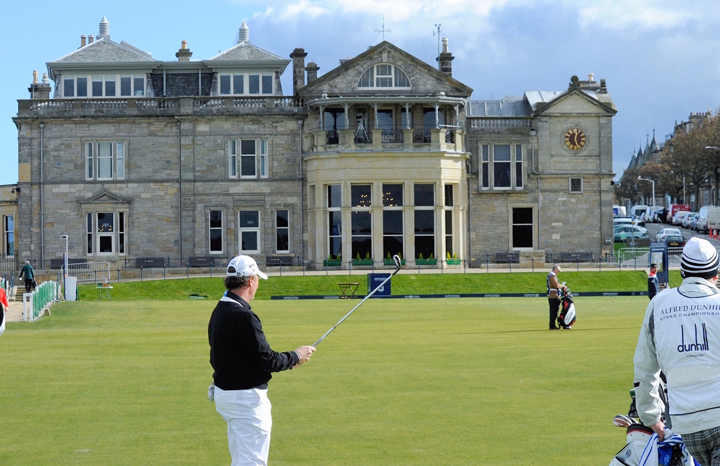
St Andrews is the "home of golf“.

Slide 6
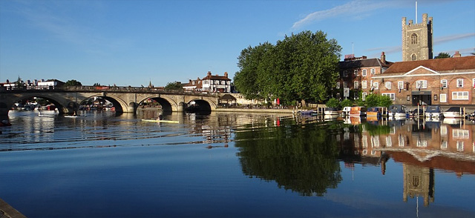
Henley is a famous centre for rowing.

Slide 7
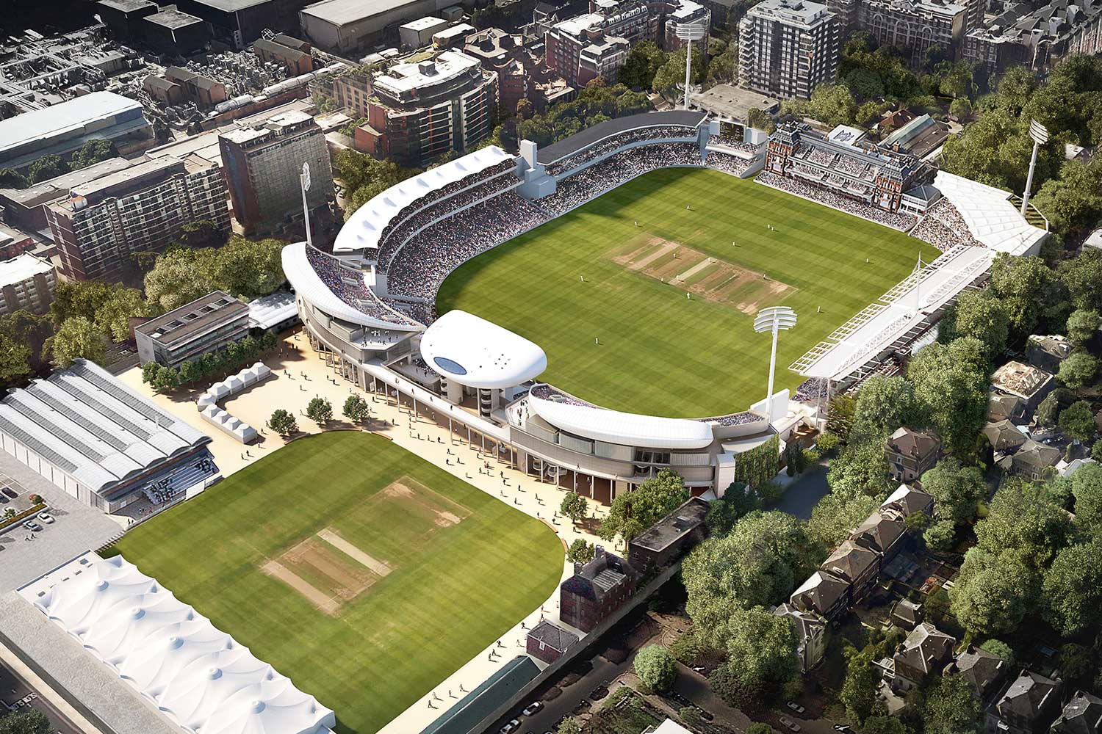
Lord's is the most famous cricket ground in the world.

Slide 8
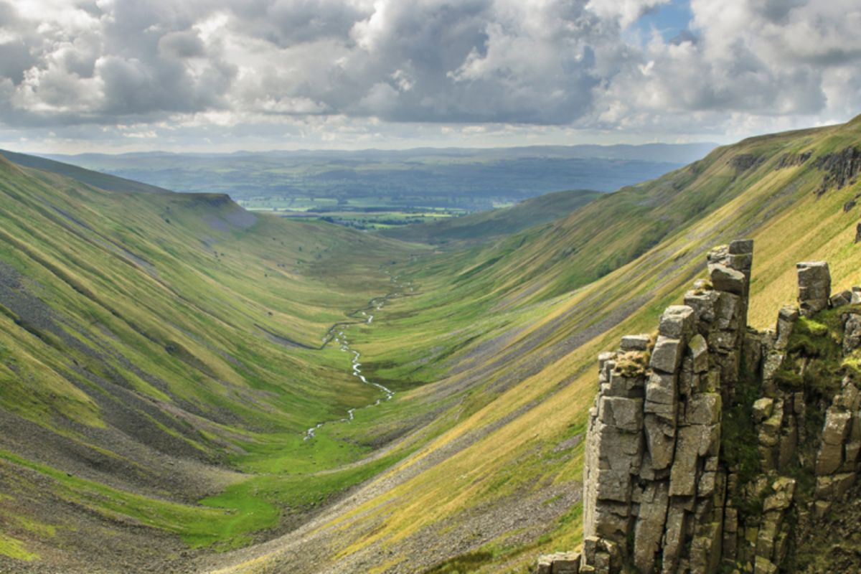
The Pennine Way (435km) is the oldest trail in England.

Slide 9
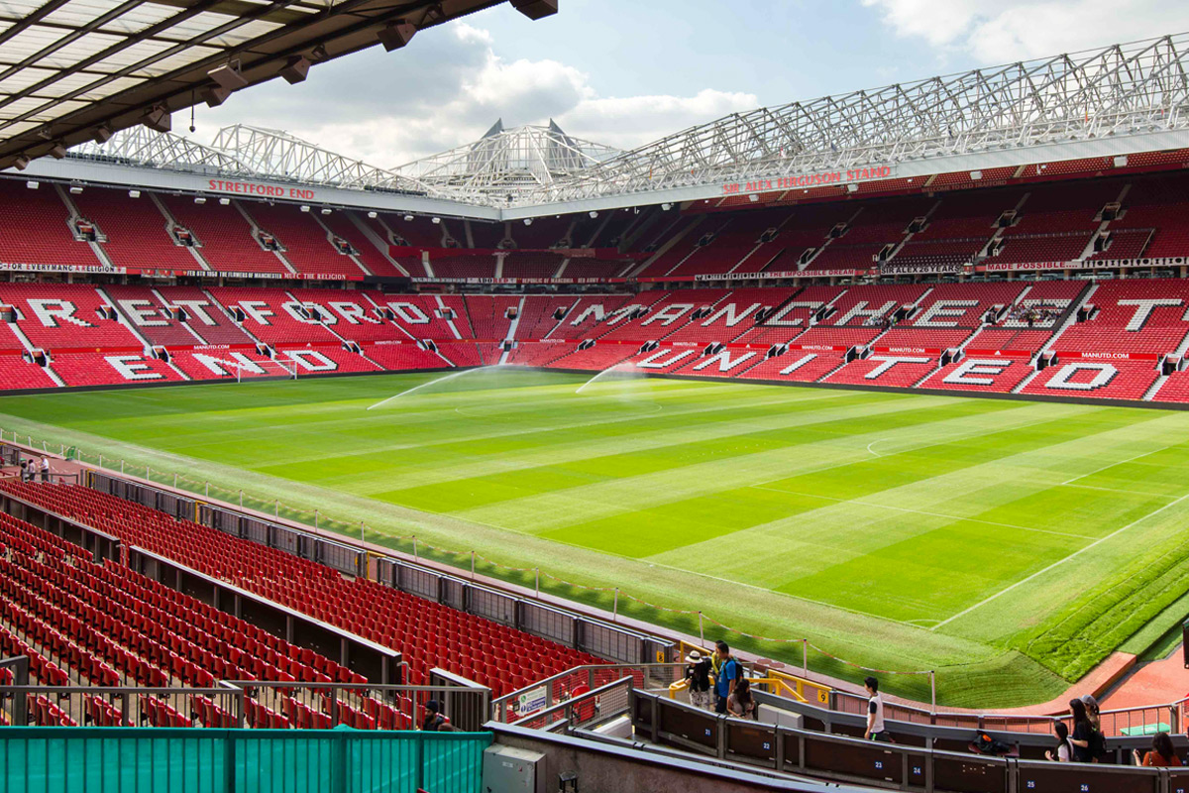
Manchester is well known as a city of sport.

Slide 10
Find the mistakes ( klaidos) and correct them:
1.Wembley is the scene of some great tennis match.
2. All cricket players want to win the tournament at Wimbledon.
3. St. Andrew’s , in Wales, is the home of golf.
4. Henley, on the river Thames, is the centre of the world of swimming.
5. Cricket is a very French game.
6. The most popular British sport is swimming.
7. About twenty percent of British people go walking.
8. British people don’t like watching sport on TV.
9. People see Manchester United play on Saturday or Sunday mornings.
10) Croquet is originally a British game.
11) You play curling on grass.

