Slide 1
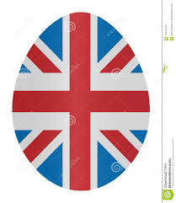

Slide 2
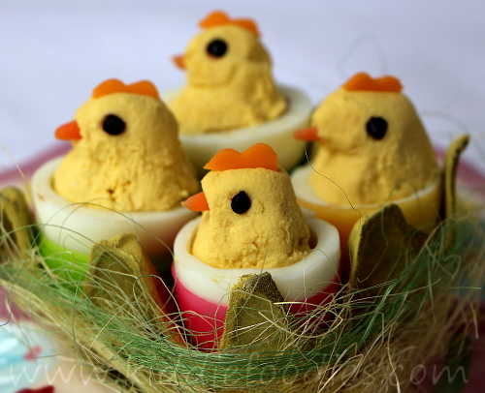
When is Easter?
Easter Sunday can fall on any date from 22 March to 25 April.

Slide 4
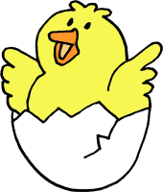
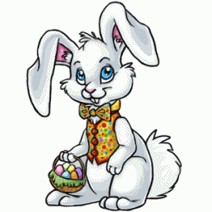
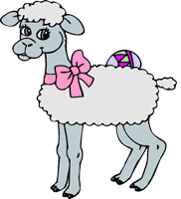
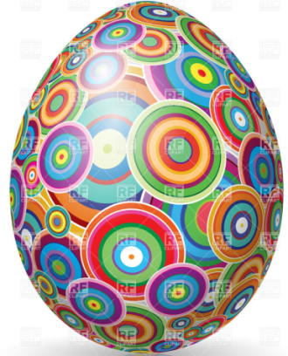
What are the symbols of Easter?
Egg, Bunny, Lamb, Chick – symbols
of life.
The Cross – the symbol of Jesus’ victory over death (mirtis,смерть).
The Candle – the light(šviesa, свет)of the world.

Slide 5
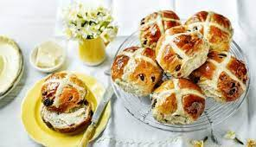
British people eat hot cross buns on Good Friday.
Hot cross buns, hot cross buns, one a penny, two a penny, Hot cross buns. If you have no daughters, give them to your sons, One a penny, two a penny, Hot cross buns.

Slide 7
Reason- priežastis, причина

Slide 8
Mean- reikšti, значить

Slide 9
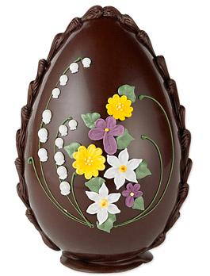
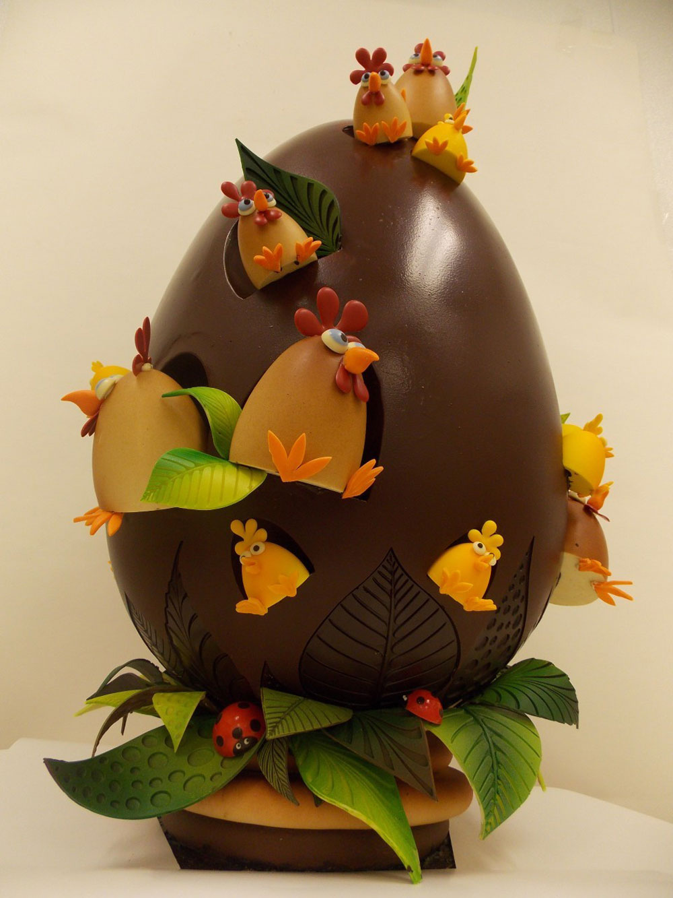
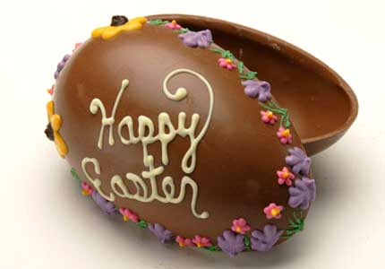
British people give each over chocolate eggs.

Slide 10
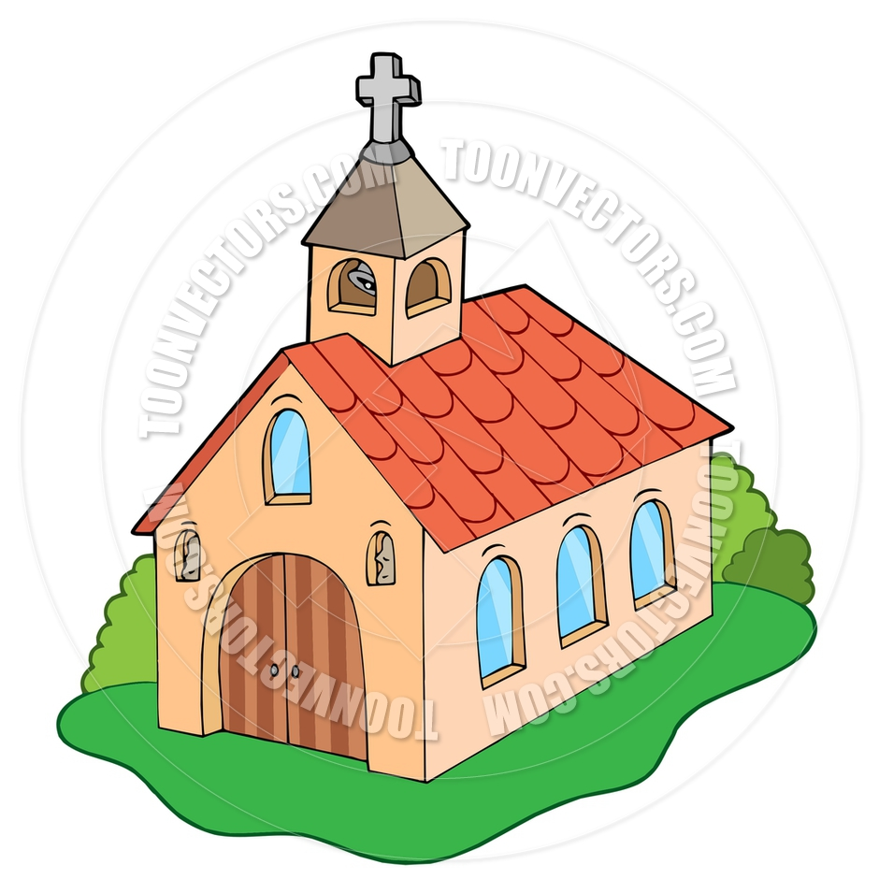
British people go to church on Easter Sunday.

Slide 11
Hunt- medžioti, охотиться
Hide –paslėpti, прятать

Slide 13
Wooden spoon- medinis šaukštas, деревянная ложка

Slide 14
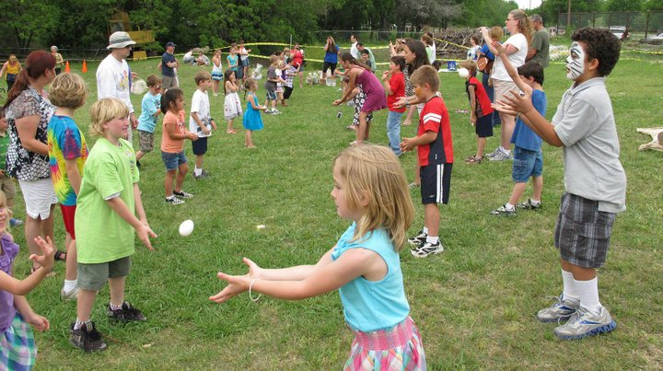
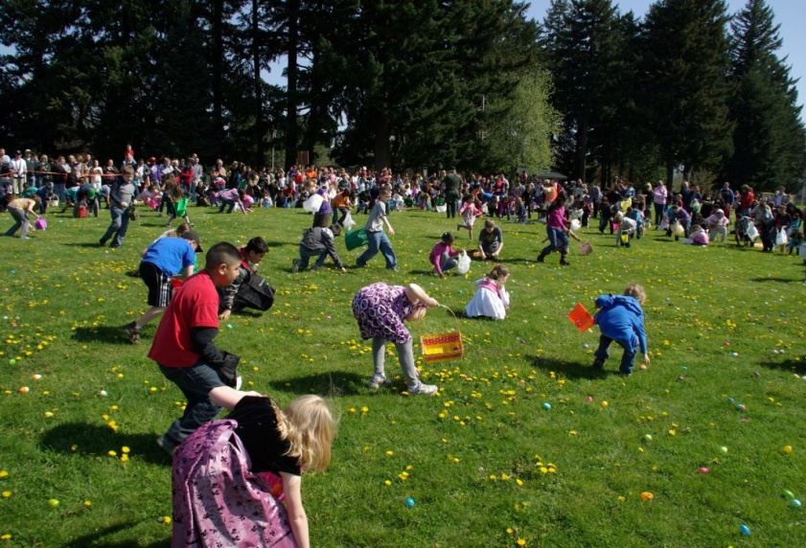
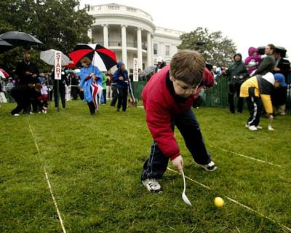
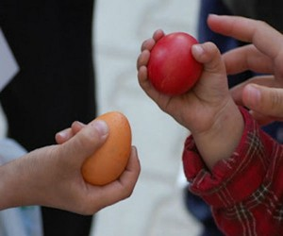
Easter games
Egg tossing- mėtymasis,подбрасывание
Egg hunting-
medžioklė, охота
Egg rolling-
rieda, катание
.
Egg tapping- bakstelėjimas, постукивание
.

Slide 15
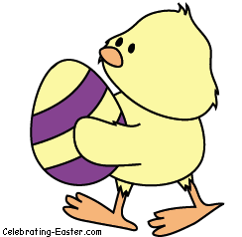
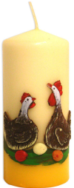
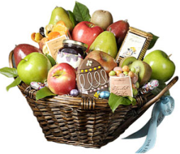
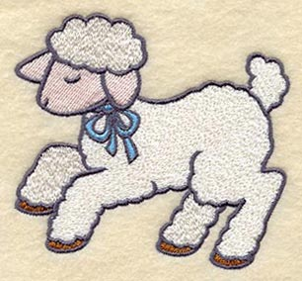
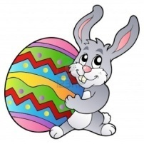
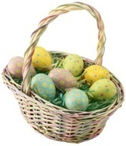
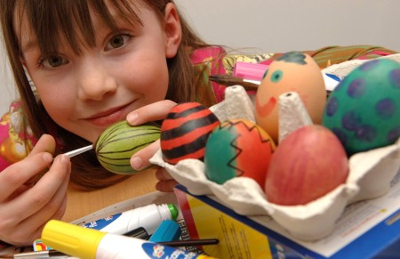
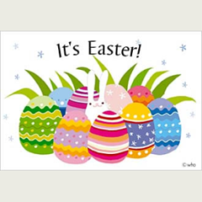
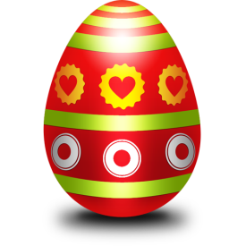
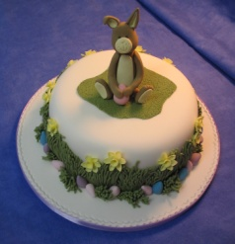
Easter Egg
Chick
Candle
Gifts
Lamb
Bunny
Basket
Card
Egg
Cake
Hunting
Rolling
Tapping
Painting
Tossing

Slide 16
Questions
Do British people go to work on Good Friday?
What do they do on Good Friday?
What traditional Easter cakes do British people eat on Good Friday?
Where do British people go in the morning on Easter Sunday?
What presents or gifts do they give each other?
What games do they play?

Slide 17
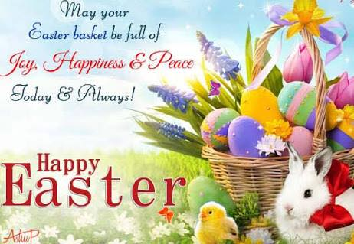

Slide 18
