Slide 1
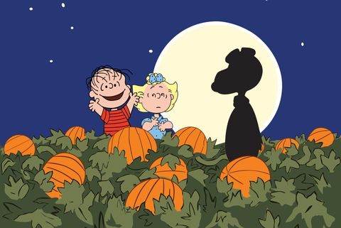

Slide 2
The traditional colors of the festival are black and orange.

Slide 3
People celebrate it in autumn.

Slide 4
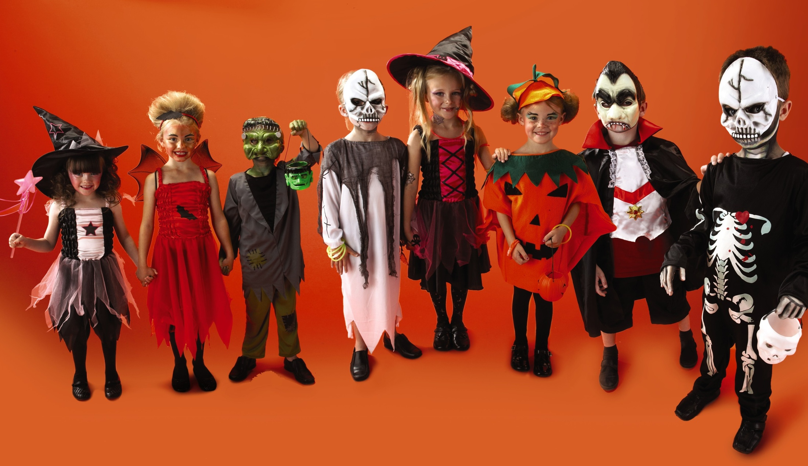
Children dress up in costumes on this festival.

Slide 5
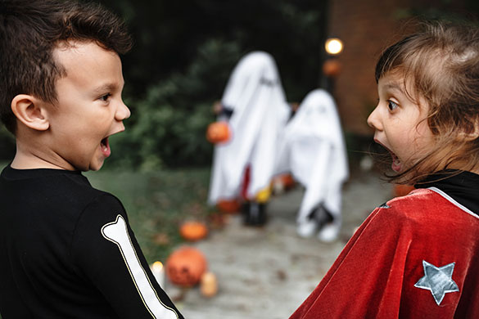
Children play tricks to scare each other.

Slide 6
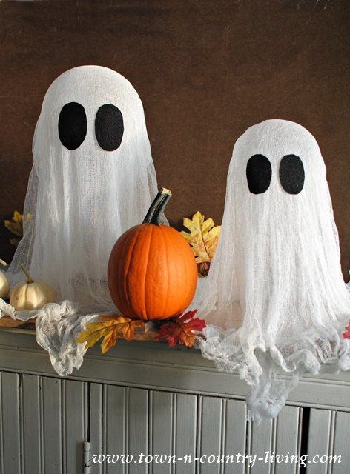
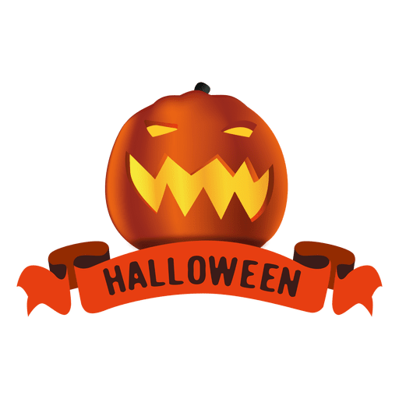
%
Celebrate celebrate – праздновать праздновать

Slide 7
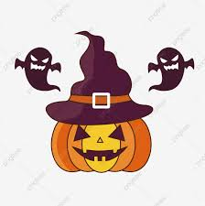
1. When do we celebrate Halloween?
2. What country does it come from?
3. What is the symbol of Halloween?
сelebrate - праздновать

Slide 8
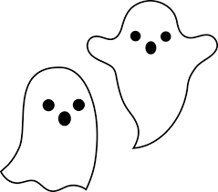
This is Britain. Halloween
1. Where are Jack and Sally from?
The USA
The UK
Australia
2. When do people celebrate Halloween?
On the 30 of October.
On the 31 of October.
On the 1of November.
3. What is a symbol of Halloween?
a potato
a tomato
a pumpkin
4. When you make a Jack-o-Lantern, you cut
eyes, a nose and a mouth.
ears, a nose and a mouth.
ears, hair and a mouth.

Slide 9
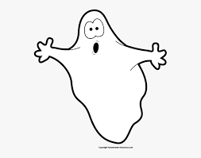
5. What is inside a Jack-o- lantern?
a lamp
a candy
a candle
6. Jack is wearing
a wizard’s costume.
a ghost’s costume.
a pirate’s costume.
7. Sally is wearing
a witch’s costume.
a ghost’s costume.
a wizard’s costume.
8. Jack and Sally are helping their mum
eat the food.
tidy the room.
make the food.

Slide 10
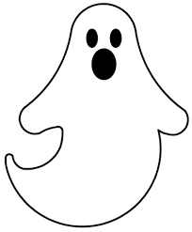
9. Sally is making scary ……………for the party.
cheeseburgers
hot dogs
sandwiches
10. Mum is worried because it’s ………….o’clock. worried -взволнованный
four
five
six
11. When children come to a Halloween party they look
scary.
funny.
sad.
12. What do people say to each other on Halloween?
“Scary Halloween!”
“Happy Halloween!”
“Merry Halloween!”

Slide 11
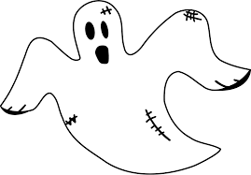
13. When Sally asks what costume her friend is wearing she says
“Who are you?”
“How are you?”
“What are you?”
14. Mum says: “Who wants more……..”
apple juice
lemon juice
orange juice
15. When children play apple bobbing, they
try to catch an apple with their teeth. сatch - ловить
try to catch an apple with their hands.
try to touch an apple with their nose. touch - трогать
16. When you want somebody to hurry up, you say: hurry up - поспешить
„Come on!“
„ Go on! “
„Get on!

Slide 12
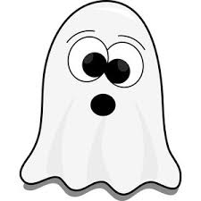
17. On Halloween children say:
„Trick and treat“
„Trick or treat“
„Treat and trick “
18.Trick or treater is somebody
who gives you sweets. give - давать
who asks for sweets. asks for - просить
who sells sweets. sell - продавать

Slide 13
Too much candy
1. Jay‘s mum is making .....Halloween costume.
her
Jake‘s
dad‘s
2. The spiders are
in the corner.
on the window.
on a swing.
3. The .....bats are hanging from the seiling.
plastic.
paper.
glass.
4. There is a .....on the swing.
ghost
a cat
a scarecrow

Slide 14
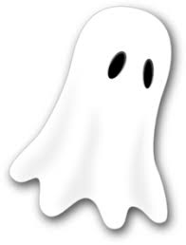
5. Dad and Jay are... the porch. Porch - крыльцо
tiding
decorating
painting
6. The Jack-o-lantern has got...eyes.
triangle
circle
square
7. The Jack-o-lantern has got...teeth.
two
three
four
8. The Jack-o-lantern has got a ... nose.
triangle
circle
square

Slide 15
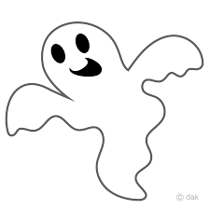
9. They put the Jack-o-lantern on a table... the bowl of candy.
behind
next to the
in front of
10. The bowl of candy is....
scary.
sad.
angry.
11. Jay is.... to have only one candy a day.
worried
not happy
angry
12. When Jay wakes up he
grabs a big handful of candy.
grabs a small handful of candy.
takes one candy.

Slide 16
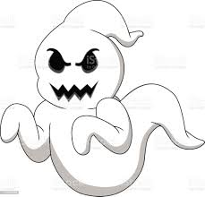
13. When Jay comes home after school the Jack-o-lantern‘s nose is
longer.
bigger.
smaller.
14. The Jack-o-lantern‘s teeth are...next day.
bigger
scarier
sharper
15. At night the boy
hears a voice.
sees a ghost.
sees a bowl of candy.
16. Jake
shouts.
wakes up.
eats candy.

Slide 17
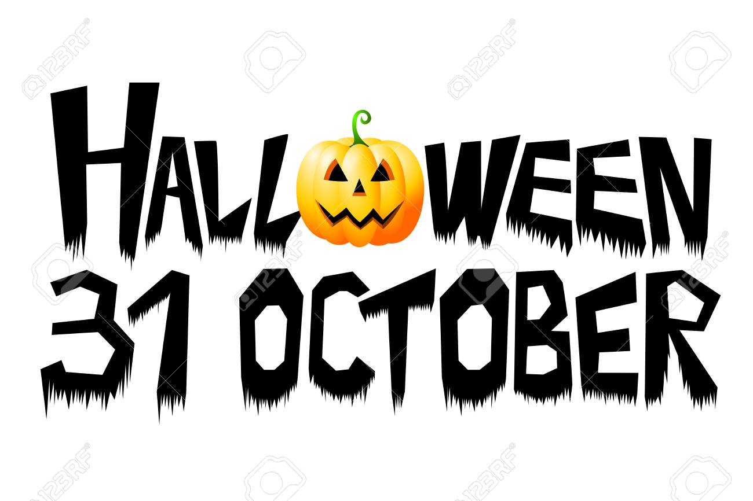
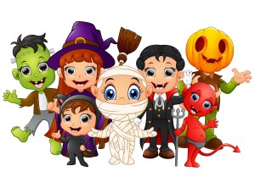
Halloween Facts for Kids People celebrate Halloween on 31 October.

Slide 18
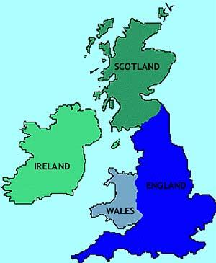
Halloween Facts for Kids
Halloween comes from Ireland and Scotland.

Slide 19
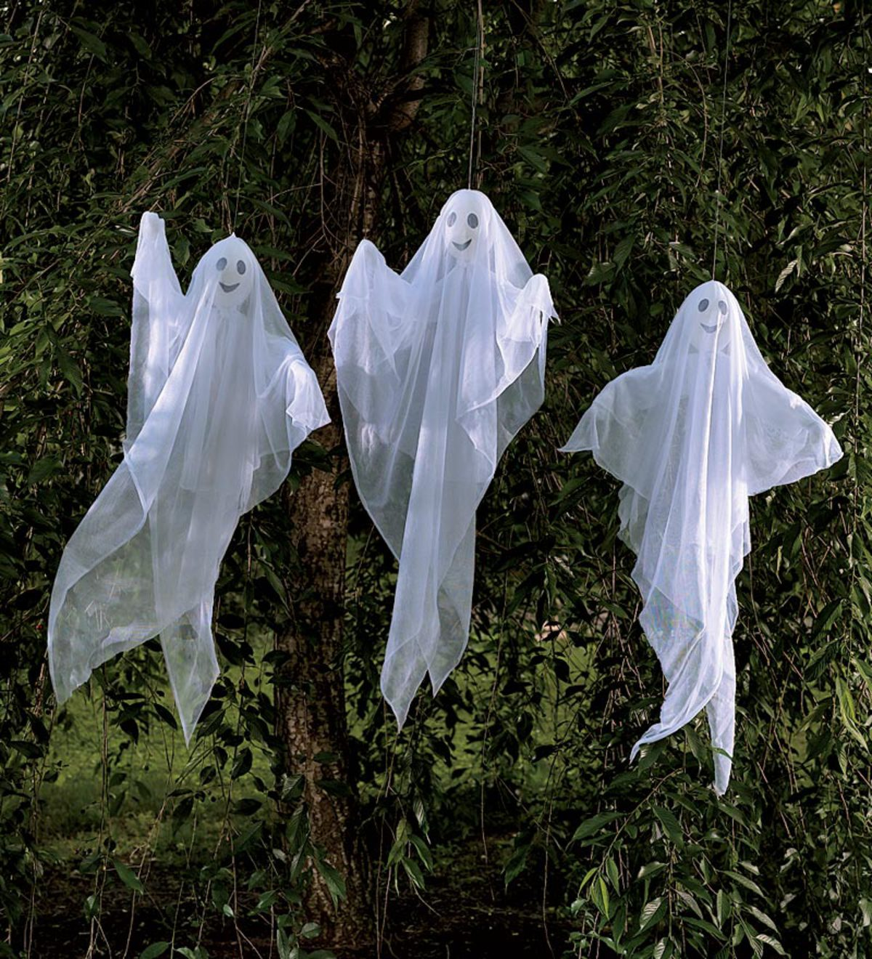
Halloween Facts for Kids
In old times people believed that on 31 October, the, spirits of ghosts come into our world.

Slide 20
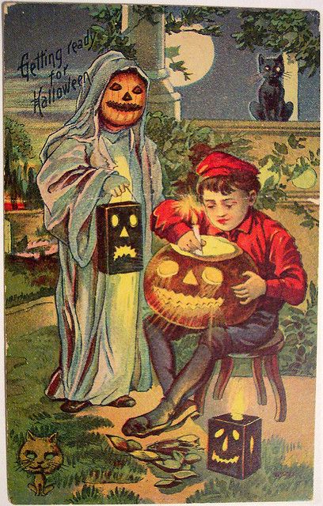
Halloween Facts for Kids
They dressed up in scary costumes to keep them away.

Slide 21
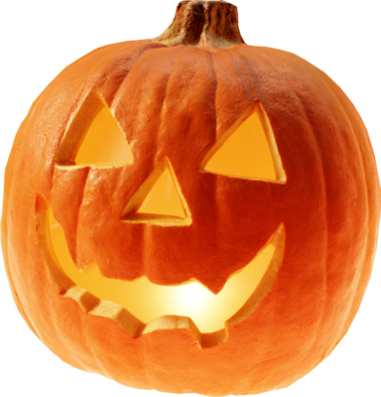
Halloween Facts for Kids
Jack-o-lantern, made of a pumpkin, is a symbol of Halloween.

Slide 22
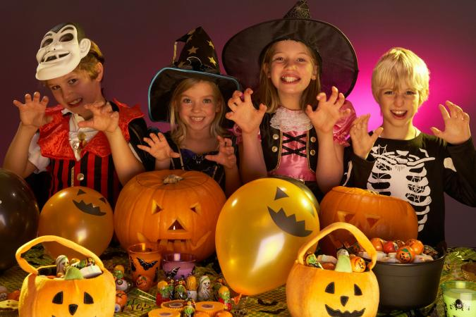
Halloween Facts for Kids
Kids and adults wear different costumes, play games, watch horror films and have parties.

Slide 23
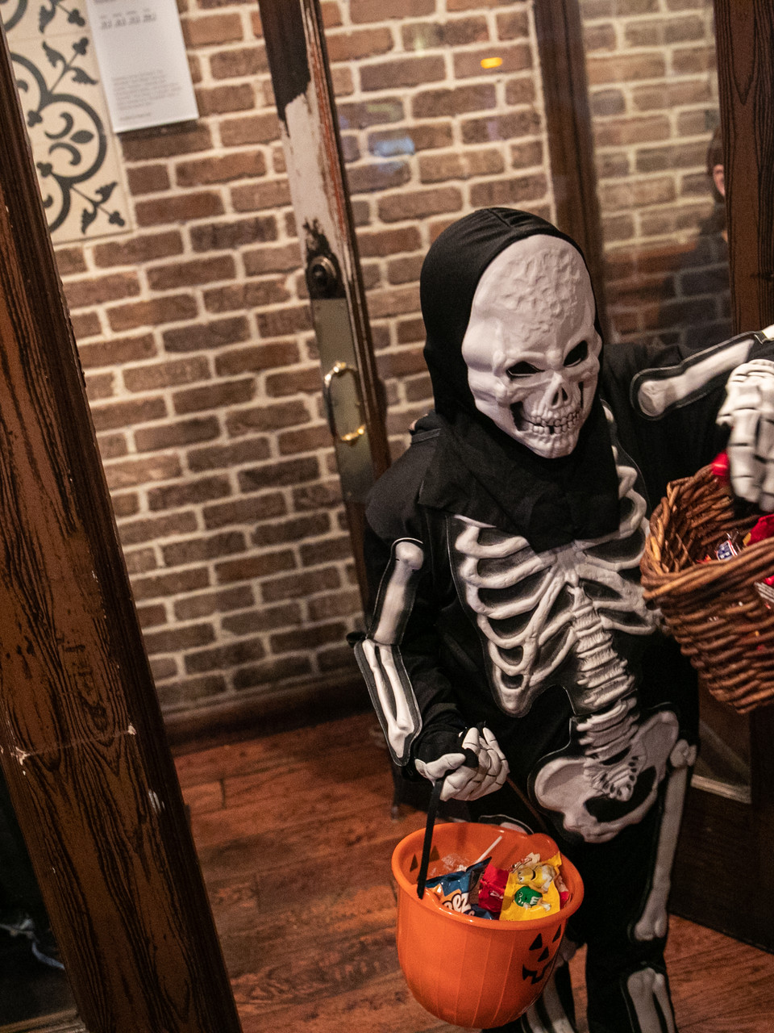
Halloween Facts for Kids
On Halloween night children dress up in costumes and walk around, knock on doors and ask for candies. They play a game called ‘Trick or Treat’.

Slide 24
Halloween Facts for Kids
People celebrate Halloween on 31 October.
Kids and adults wear different costumes, play games, watch horror films and have parties.
Halloween comes from Ireland and Scotland.
In old times people believed that on 31 October, the, spirits of ghosts come into our world.
They dressed up in scary costumes to keep them away.
On Halloween night children dress up in costumes and walk around, knock on doors and ask for candies. They play a game called ‘Trick or Treat’.
Jack-o-lantern, made of a pumpkin, is a symbol of Halloween.

