Slide 1
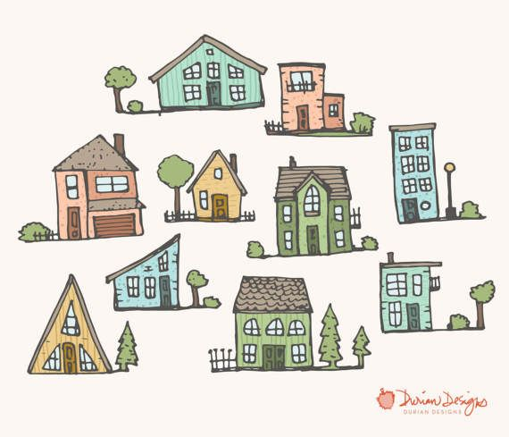
Homes in Great Britain

Slide 2
Typical |ˈtɪpɪk(ə)l|- tipiškas, типичный
Shape |ʃeɪp|forma, форма
Size |saɪz| dydis, размер
Average |ˈæv(ə)rɪdʒ| vidutinis, средний
Cooker |ˈkʊkə| viryklė, плита, печь
Oven |ˈʌvən| orkaitė, печь, духовка
sink |sɪŋk| kriauklė, раковина
kettle |ˈket(ə)l| virdulys, чайник
Prefer |prɪˈfɜː|teikti pirmenybę, предпочитать
To be keen on būti užsidegusiam, увлекаться
Detached house individualus namas, отдельно стоящий дом
Semi-detached house dvibutis namas, сблокированный дом
Mansion|ˈmænʃ(ə)n|dvaras, большой особняк

Slide 3
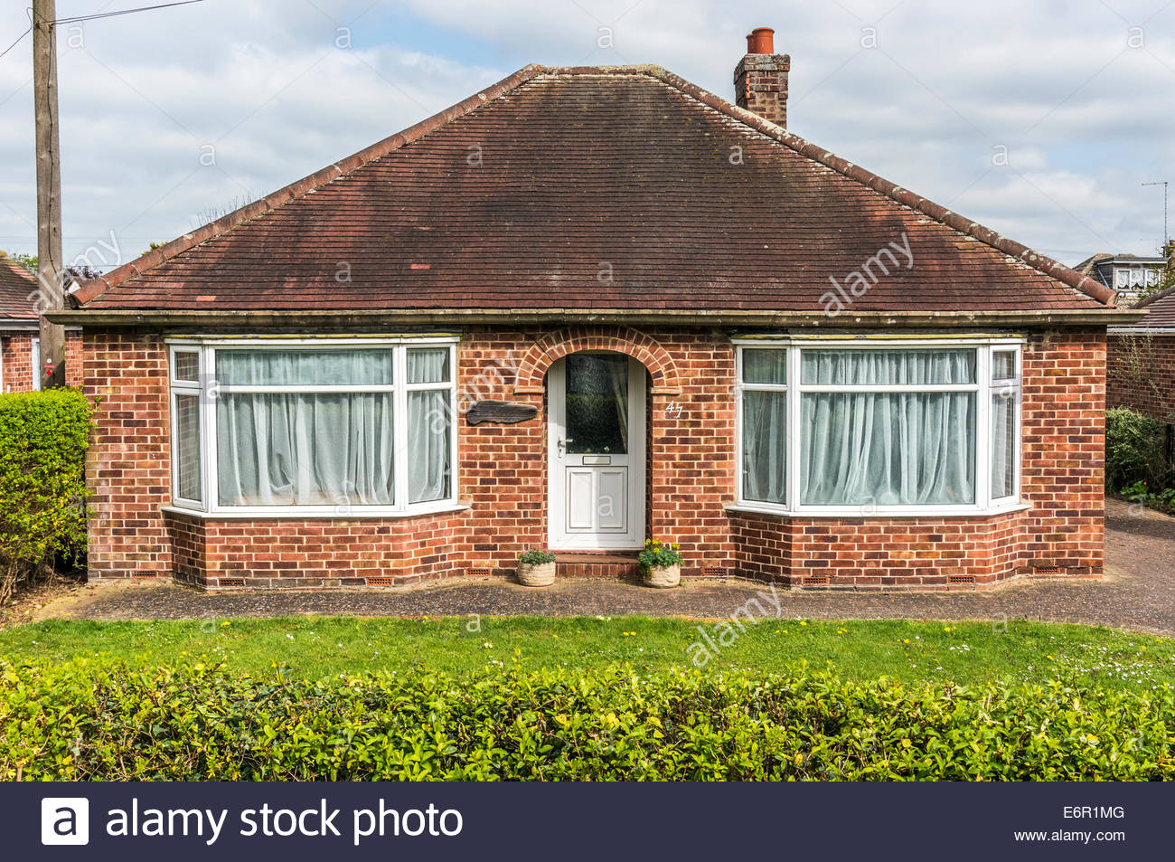
bungalow

Slide 4
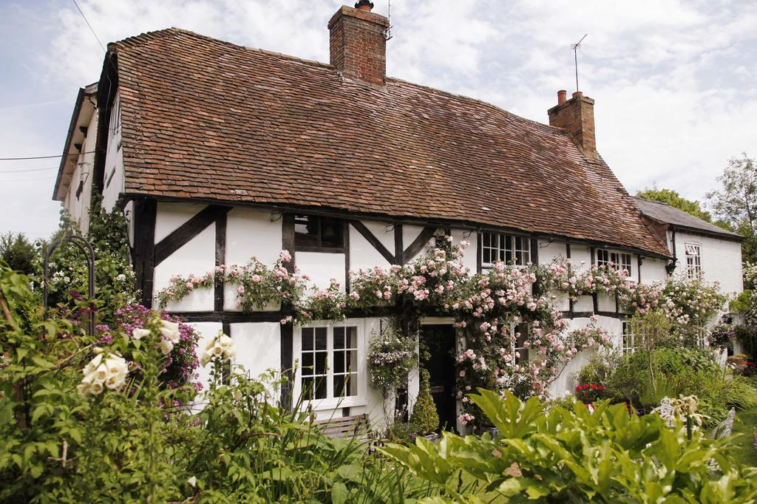
cottage

Slide 5
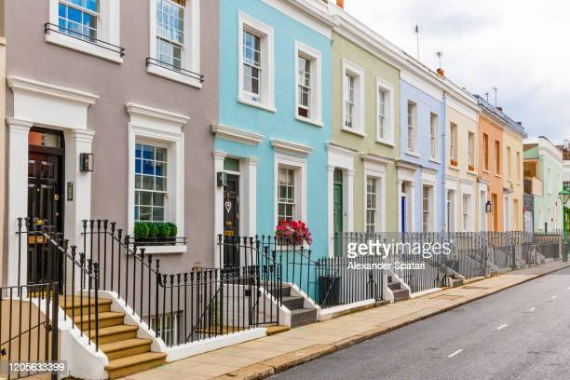
Terraced house

Slide 6
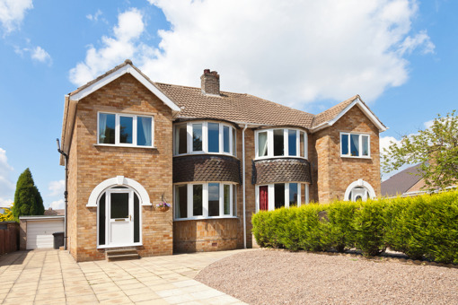
Semi-detached house

Slide 7
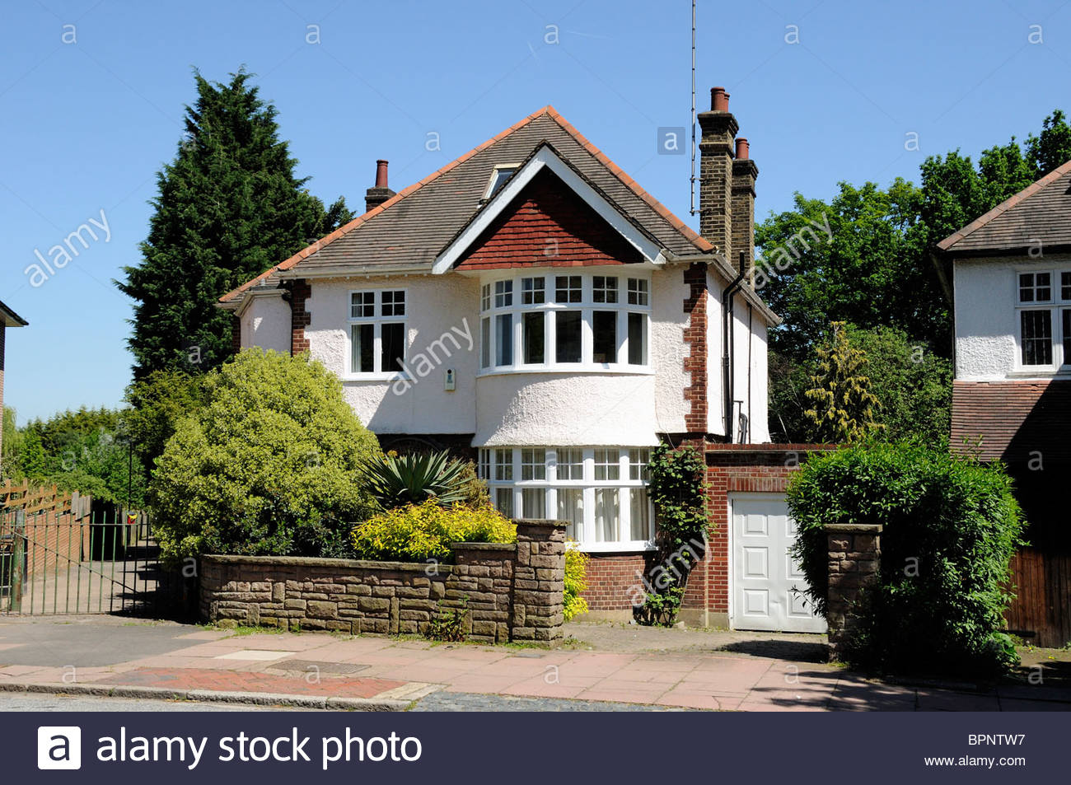
Detached house

Slide 8
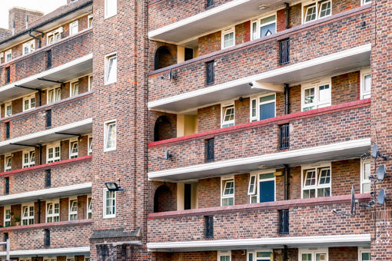
Block of flats

Slide 9
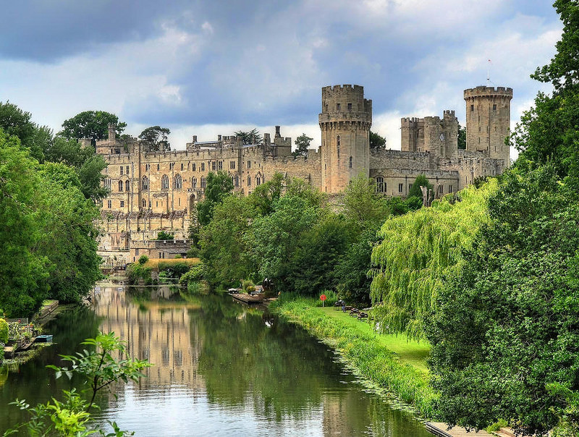
Castle

Slide 10
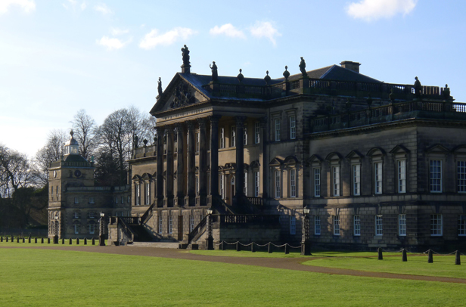
mansion

Slide 11
Fill in the gaps with missing words: the living room, Buckingham palace , gardening, study, a kettle, houses, a writer, special meals, prefer, shapes and sizes, keen on,
Most British people live in……… .
Houses are all different ………… ……….. .
People read, watch TV , relax, play games in ………… .
If you make tea, you need ………… .
The dining room is a room for …………….. .
Some British people like having a shower , but most ……….. a bath.
Mrs. Robinson is a ………… and she works in her……….. .
A lot of British people really like ……………. .
The British are very ………… pets.
The queen lives in ………….

