Slide 1
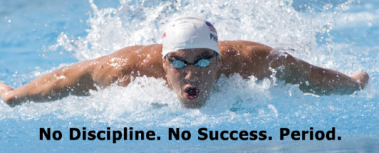

Slide 2
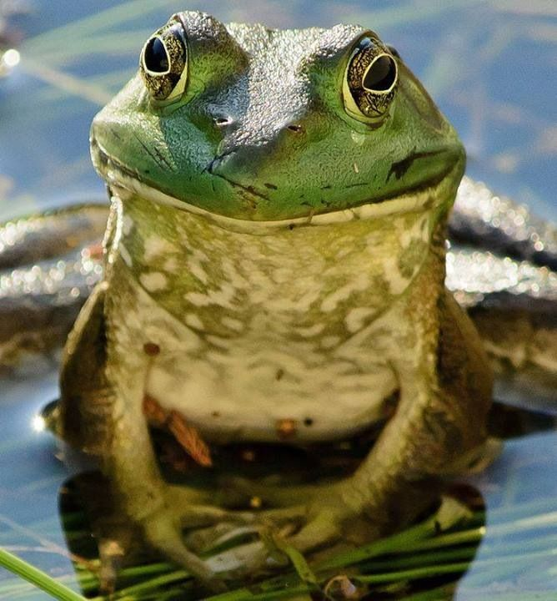
Eat the biggest frog

Slide 3
Take steps every single day

Slide 4
Delay the reward

Slide 5
Praise yourself

