Slide 1
St Valentine’s day vocabulary

Slide 2
Gave me - davė man, дал(a) мне

Slide 3
a card

Slide 4
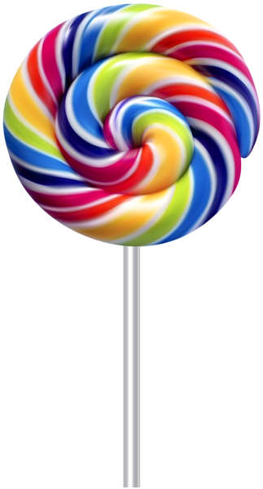
a lollipop

Slide 5
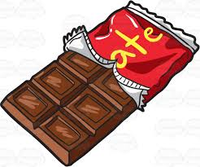
a chocolate bar

Slide 6
a candy

Slide 7
a red flower

Slide 8
A cupcake

