Slide 1
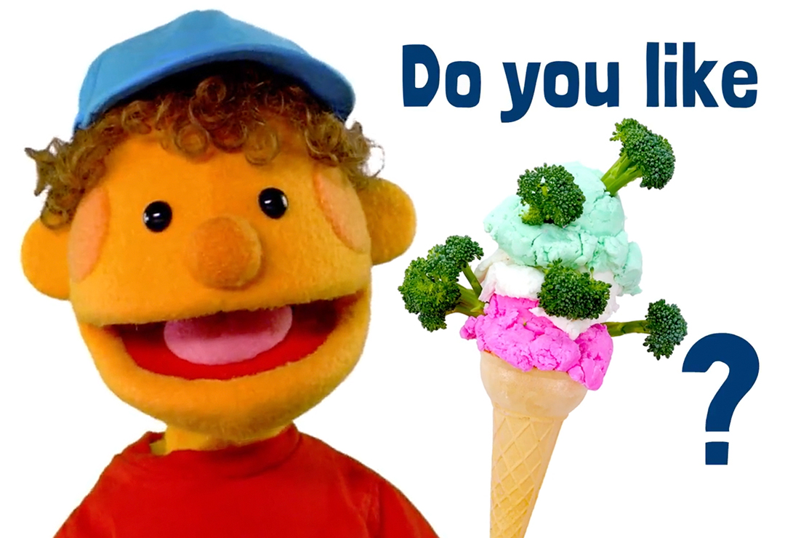

Slide 2
Like |laɪk|mėgti, любить
Do you like?
AR TAU PATINKA?
ТЕБЕ НРАВИТСЯ?
YES, I DO. V
NO, I DON’T. X

Slide 3
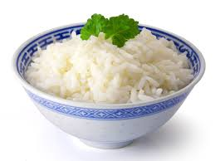
Do you like rice?
V Yes, I do.
X No, I don’t.

Slide 4
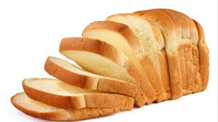
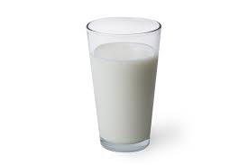
Do you like…?

Slide 5
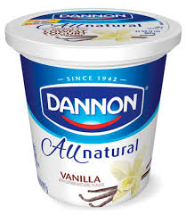
Do you like…?

Slide 6
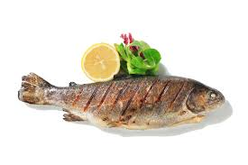
Do you like…?

Slide 7
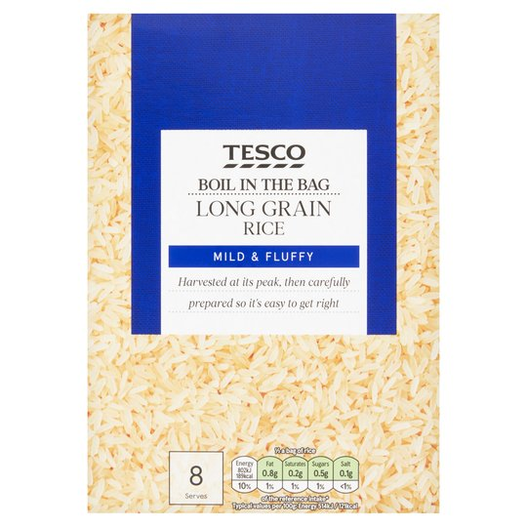
Do you like…?

Slide 8
Do you like…?

Slide 9
Do you like…?

