Slide 2
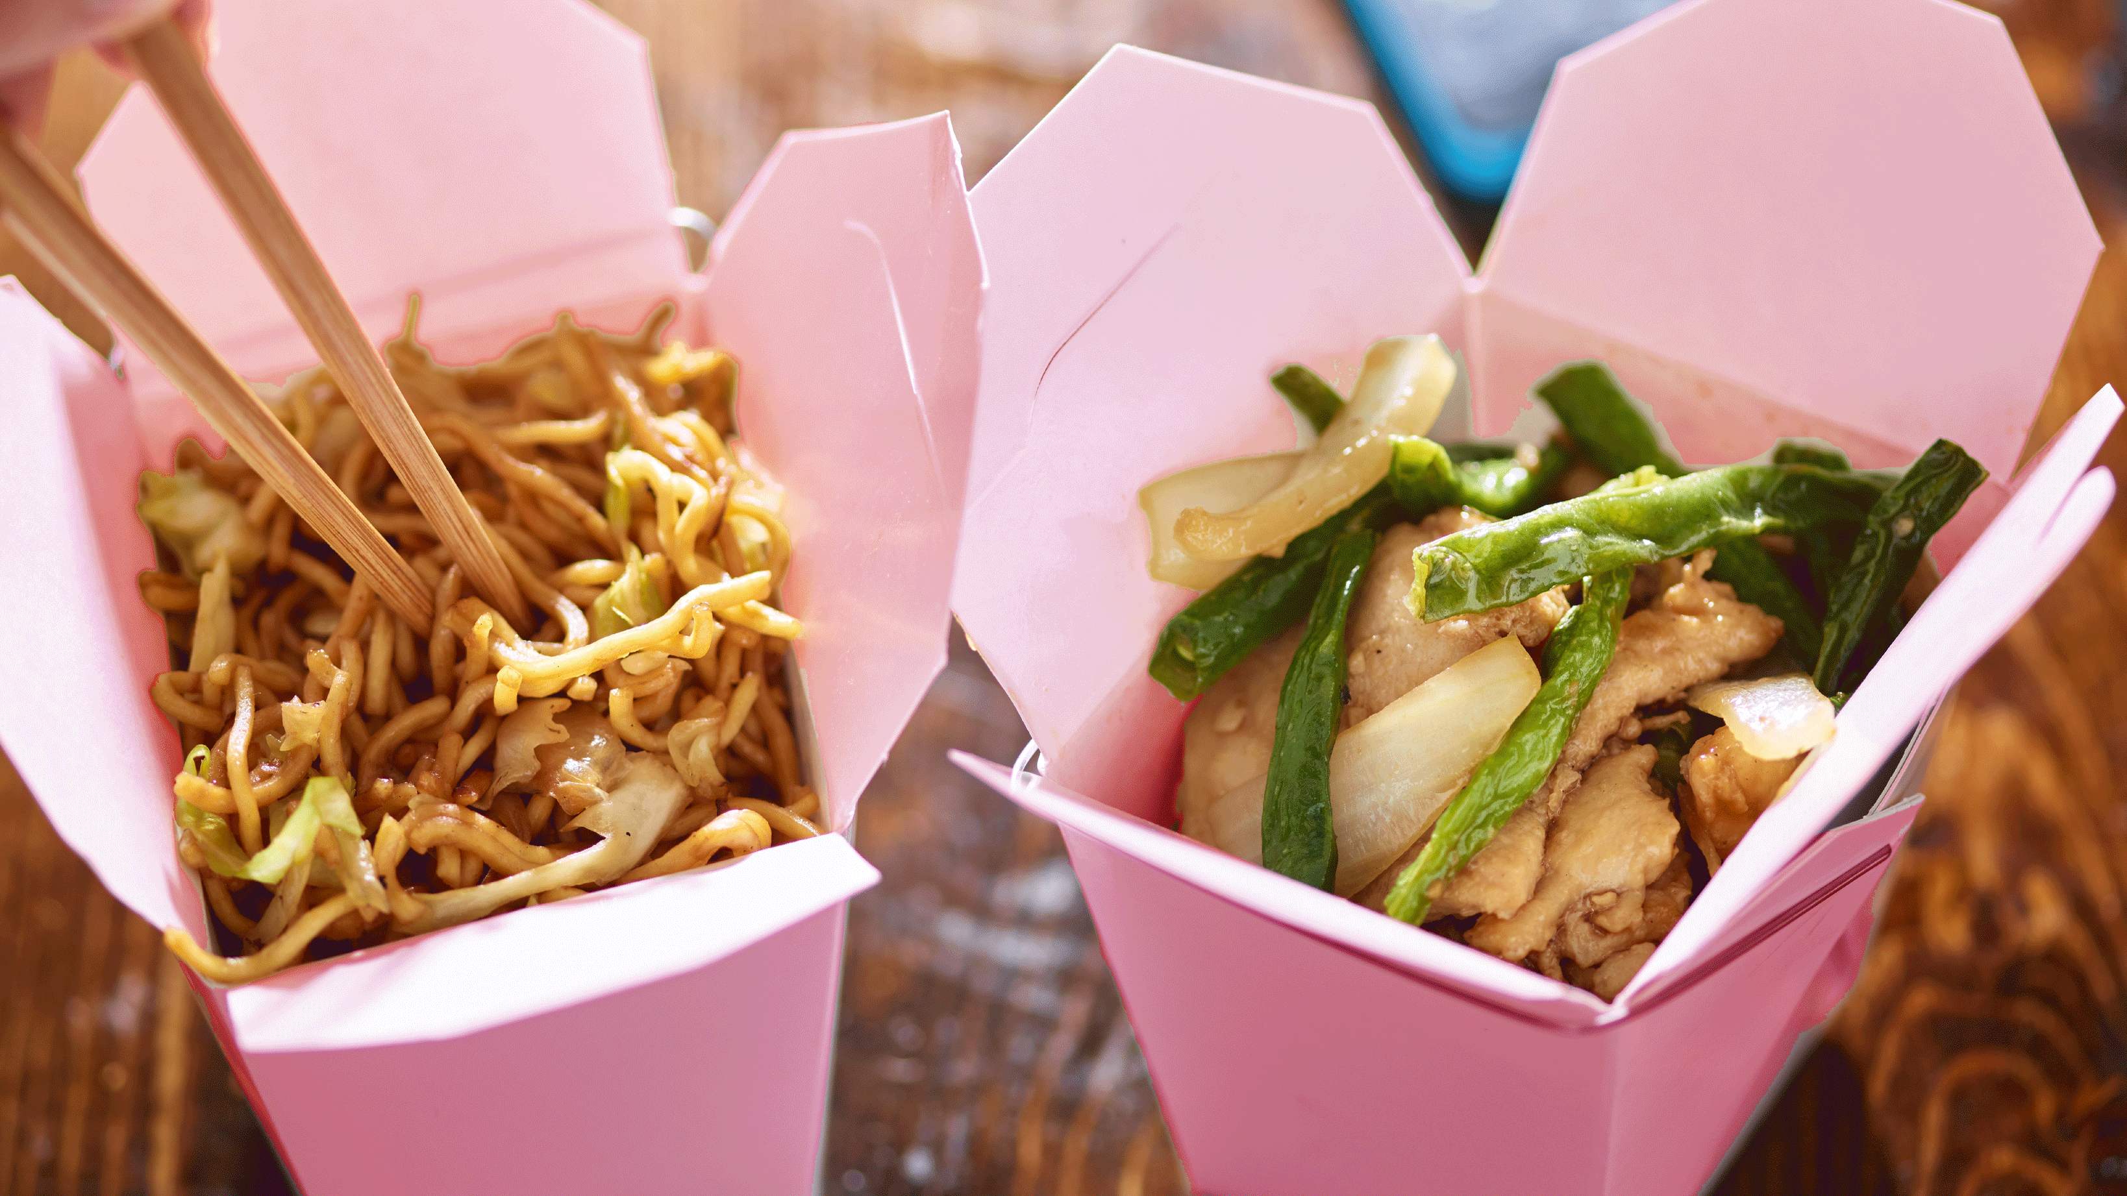
Take away food-maistas išsinešimui, eда на вынос

Slide 3
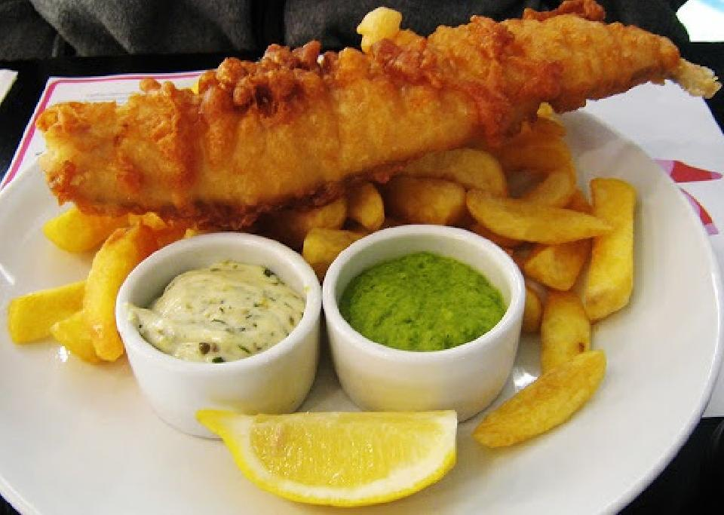
FISH AND CHIPS - is a hot dish consisting of fried fish in batter(tešlą, тесто) served with chips.

Slide 4
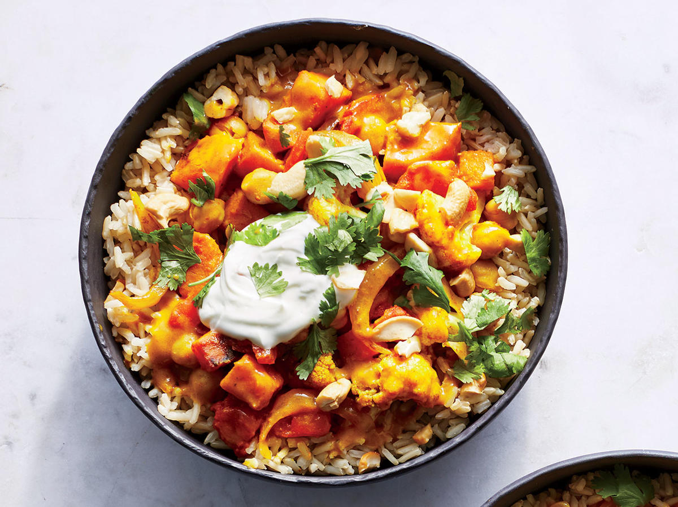
vegetable curry and rice - daržovių karis, овощное блюдо, приправленное карри

Slide 5
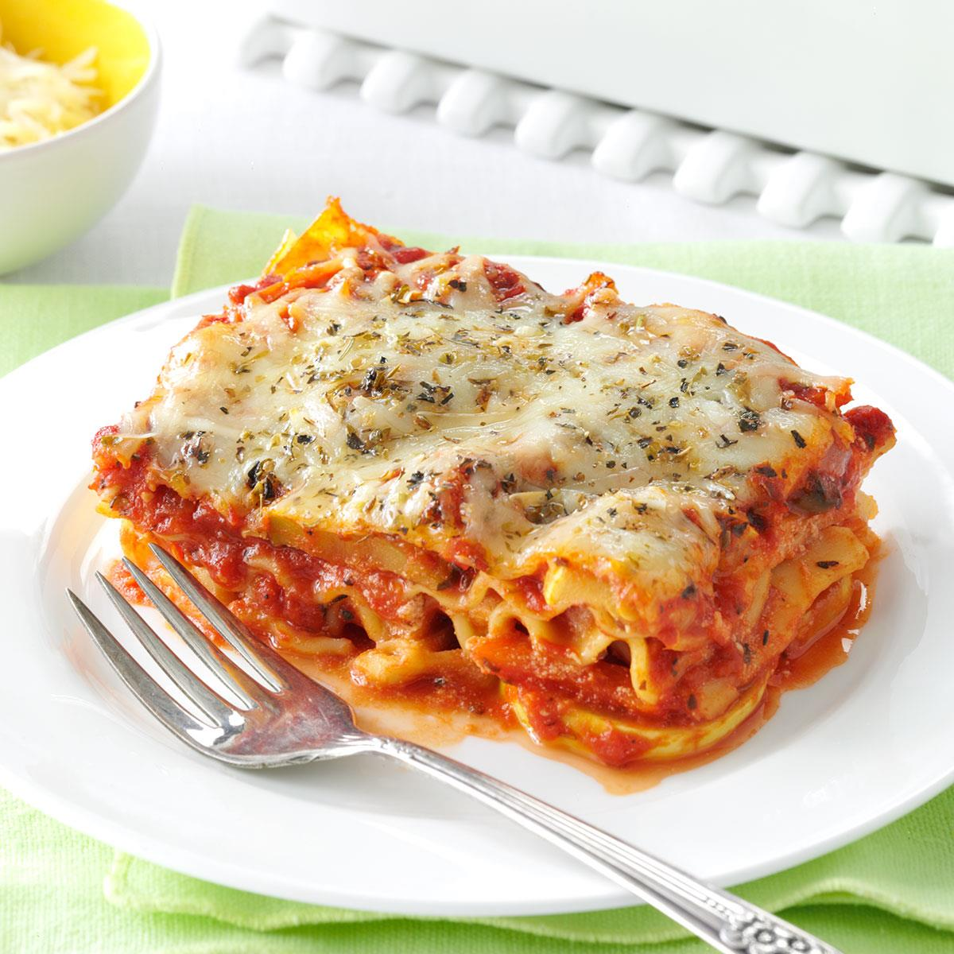
vegetable lasagne- daržovių lazanija, овощная лазанья

Slide 6
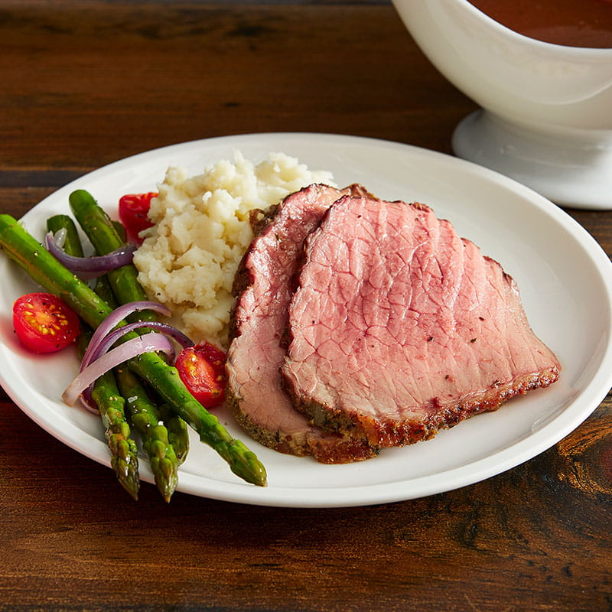
ROAST BEEF - kepta jautiena, жареная говядина

Slide 7
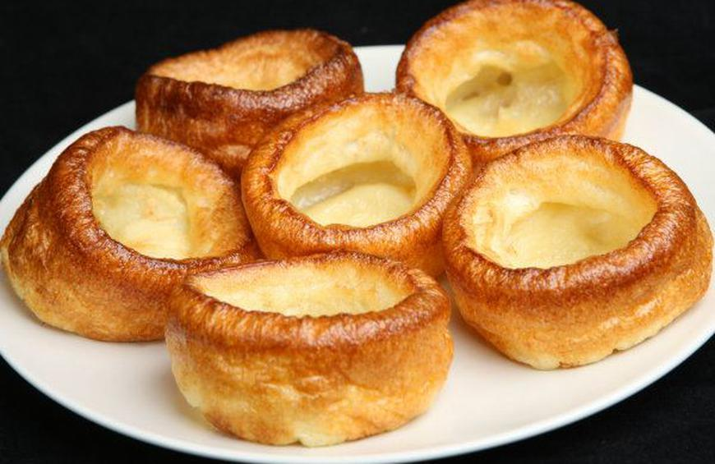
YORKSHIRE PUDDING - JORKŠYRO PUDINGASЙОРКШИРСКИЙ ПУДИНГ

Slide 8
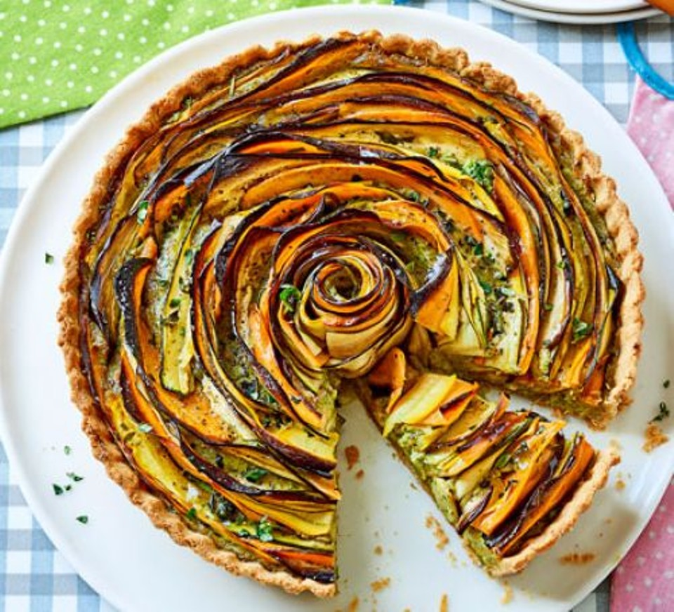
VEGETABLE TART – daržovių piragas, овощной пирог

Slide 9
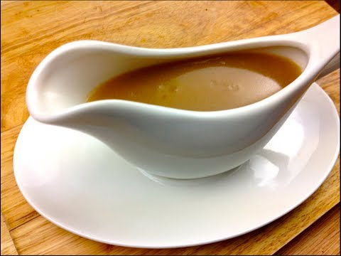
GRAVY-padažas, соус

Slide 10
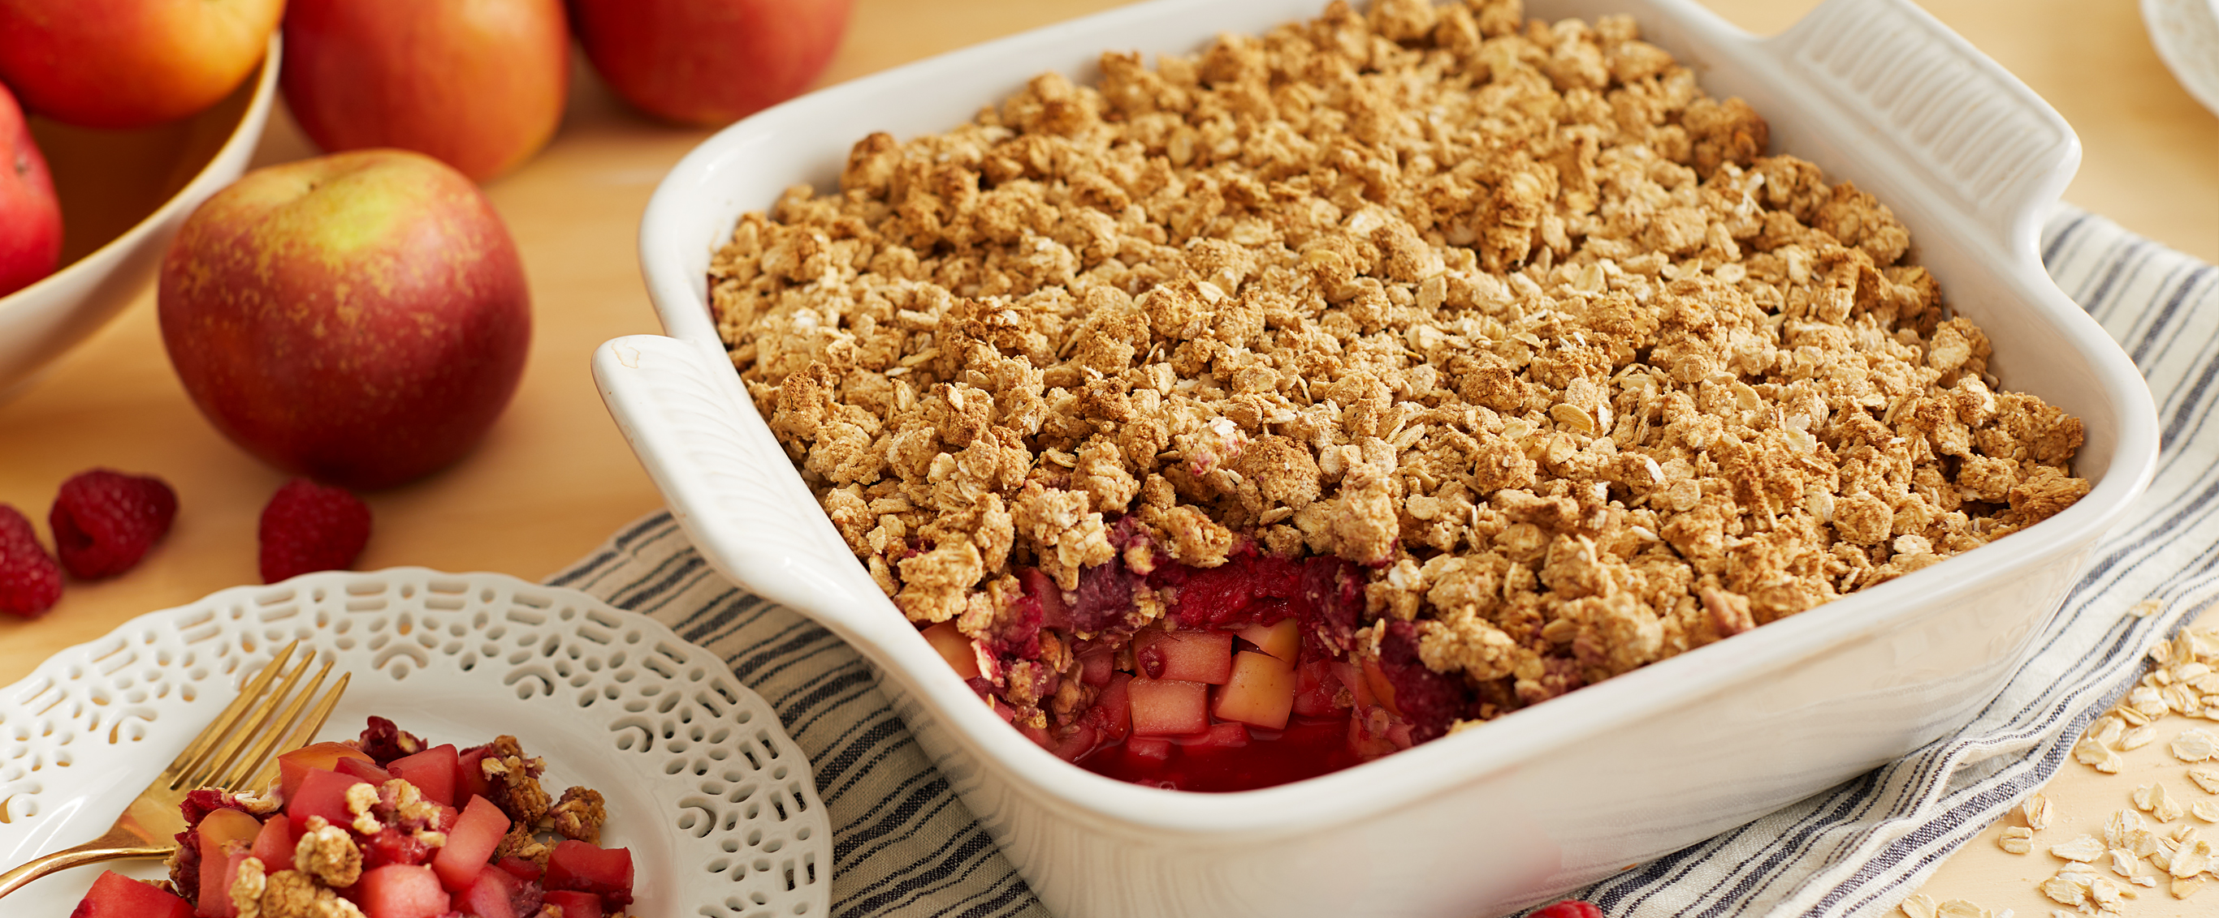
apple crumble- obuolių apkepas, яблочная крошка (пирог)

Slide 11
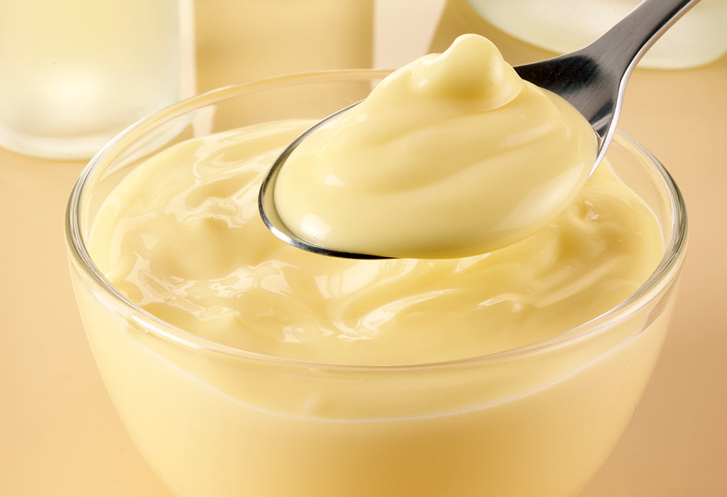
Custard- plikytas kremas, заварной крем

Slide 12
Fill in the gaps with missing words: meat, vegetable tart , take away, vegetable lasagne, crisps, custard, a banana, Cambridge, shopping list, sandwich, vegetarian, juice, Nick, twelve, apple crumble, roast beef, apples, Yorkshire pudding
1. The boy’s name is………… .
2. He is………… .
3. He lives in……..
4. Nick and Molly have …... .., ..…, ….. and a ………… in their packet lunch.
5. They sometimes have a……. ………on Friday evening.
6. Before going to the supermarket they make a………. ……….. .
7. Dad’s going to make a…………. ………… tonight.
8. After going to the supermarket they have a ………. for lunch.
9. They are going to have….... ……… and……… ……..this Sunday for lunch.
10.For dessert they will have……….. ………. and………..
11 . Jean isn’t going to eat any …………because she is a………… .
12. There is a ………….. …………… in the oven for mum.

