Slide 2
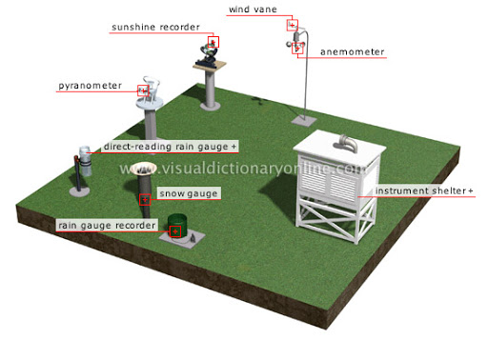
Meteorological station studies the weather and climate. (meteorologijos stotis, метеостанция).

Slide 3
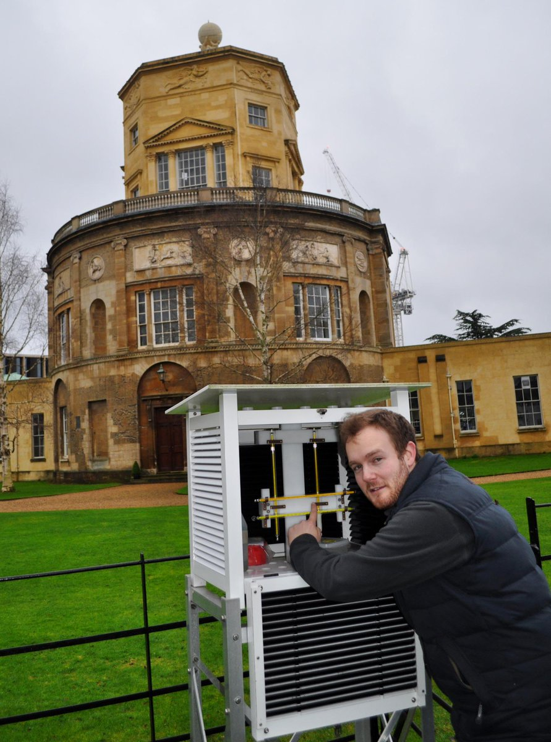
Radcliffе
meteorological
Station in Oxford

Slide 4
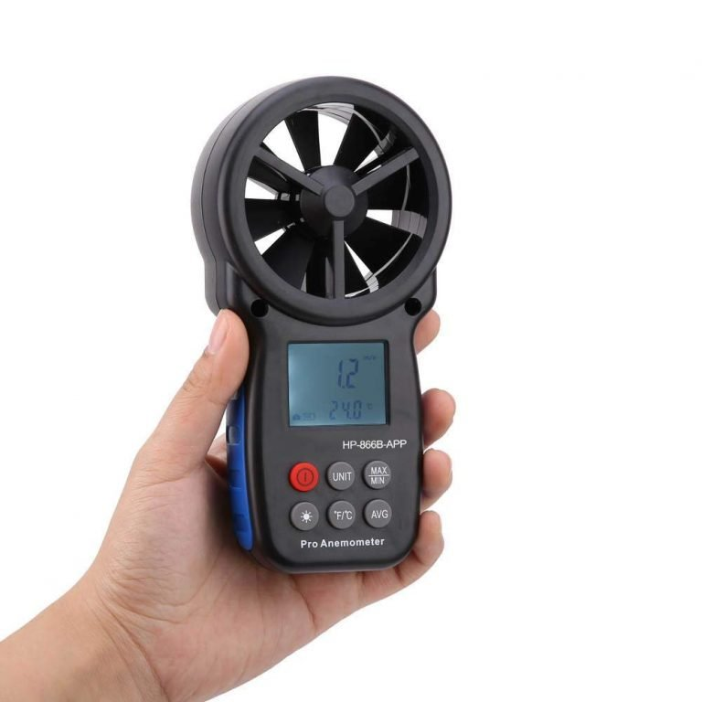
Measure /ˈmɛʒə/ matuoti измерять

Slide 5
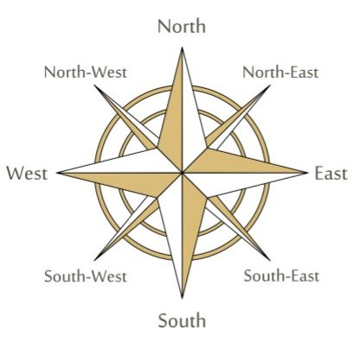
šiaurė ,север
vakarai, запад rytai, восток
рietus, юг

Slide 6
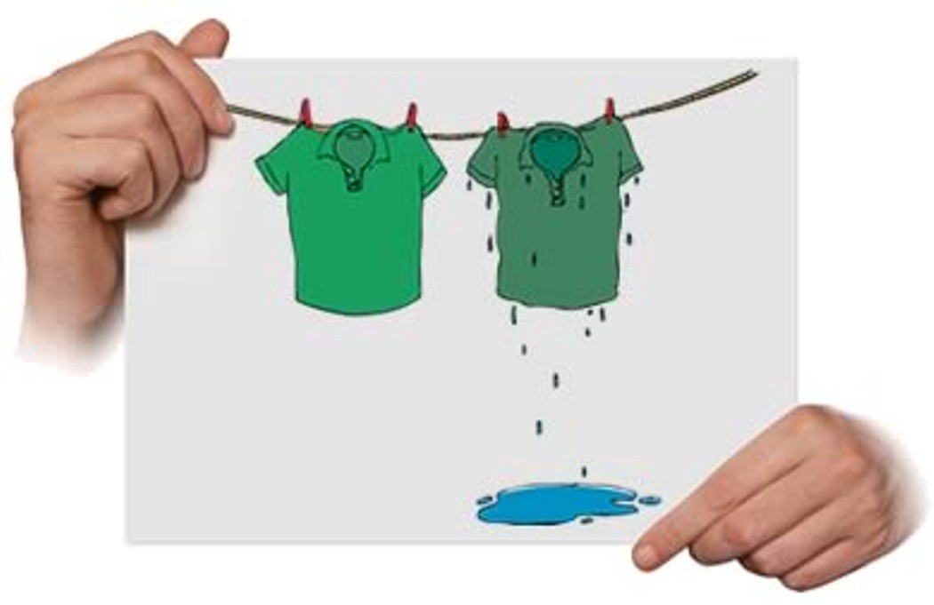
Dry- sausas, сухой wet- drėgnas, влажный

Slide 8
Drop – mesti, уронить, ронять
To drop rain

Slide 9
Cool weather - Vėsus oras, Прохладная погода

Slide 10
Scientist- mokslininkas,ученый

Slide 11
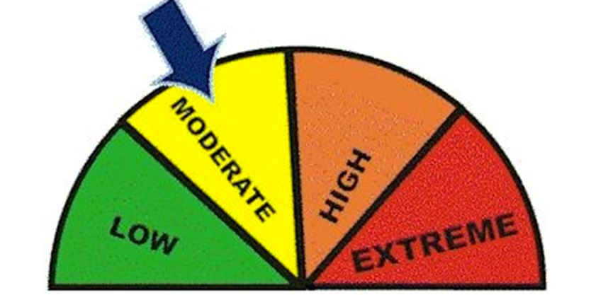
Moderate – saikingas, yмеренный

Slide 12
Finish the sentences:
1)Radcliffе meteorological station is in O………. .
2) Here you can measure temperature, wind and r…… .
3) It is the o………….. weather station in GB.
4) The west of the UK is much w………. than the east of the UK.
5) Some people call Kent the g……. of England because of its warm c…...
6) Different parts of Britain have d………… climates.
7) Places in the west are w……… than places in the east.
8) Places in the north are c…….. than places in the south.
9) In general, Britain has a m…………. climate.
10) The weather in Britain changes very q……….. .

